Slide 1

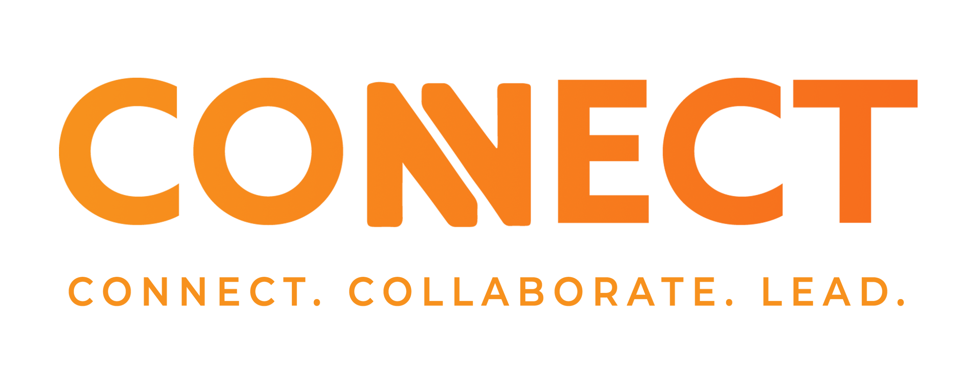

Basics to Achieving Breakthrough Engagement
Jill Hallman and Raylene Thompson, MBA, CPXP
Notes:
Let’s see a raise of hands if you have seen the movie “Back to the future” A very popular movie series where Marty McFly and Doc Brown went back in time
explored themes about time, relationships and personal growth.

Slide 2
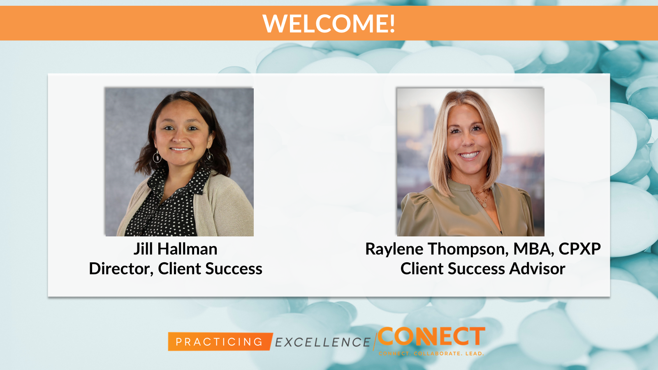

Slide 3


Agenda for Today...
Foundations of engaged teams
Impact of mindset and culture on team engagement
Engagement best practices
Resources for support
Notes:
CSM

Slide 4
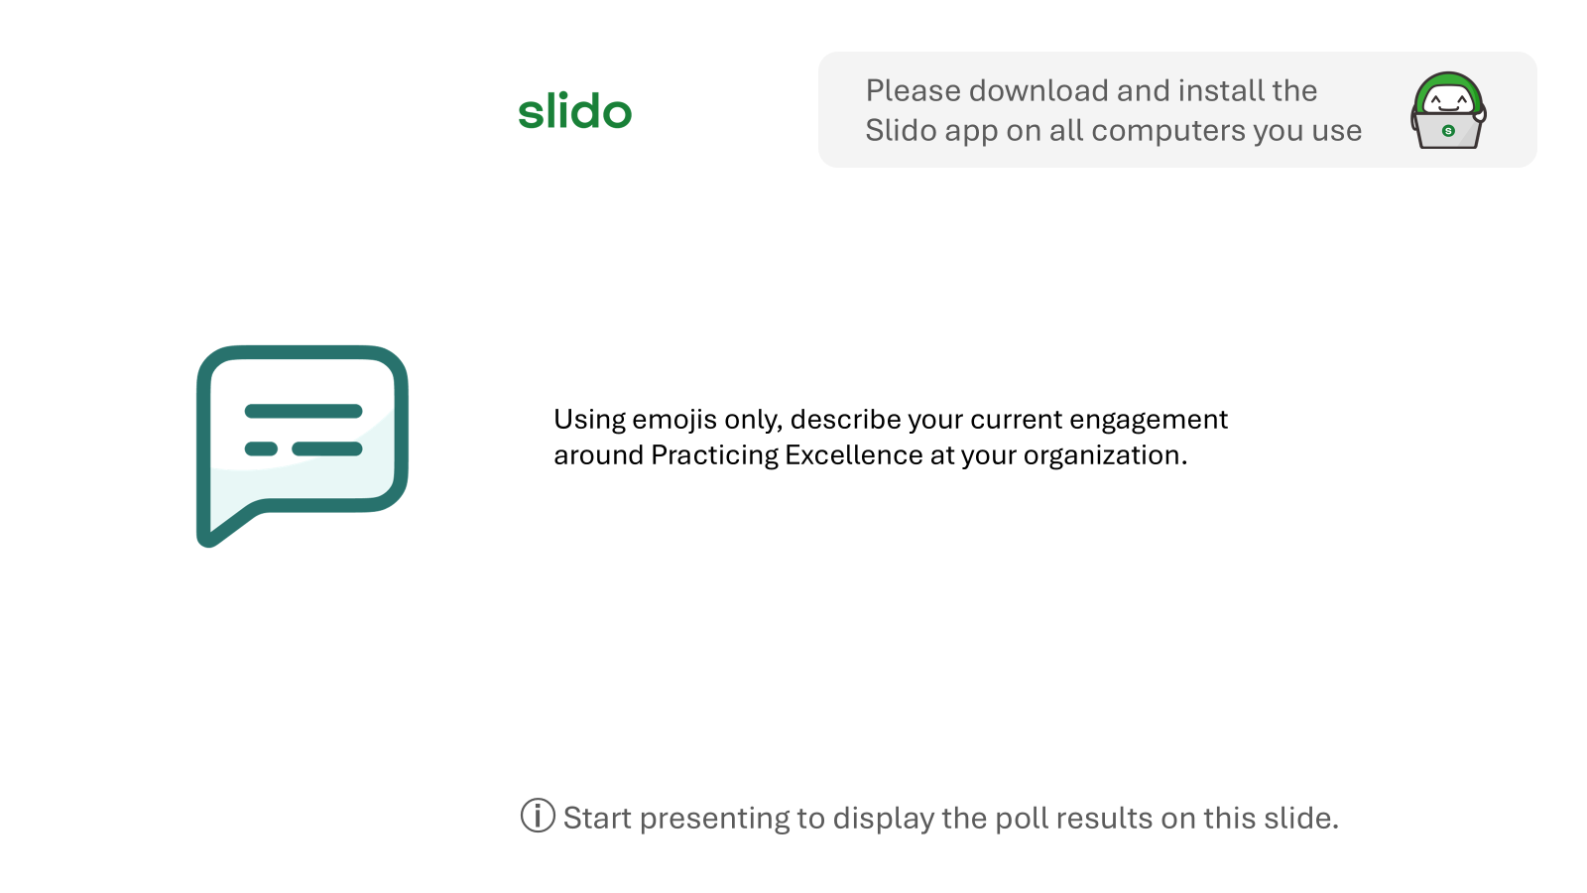

Slide 5



The “Science” of Engagement
Notes:
"Welcome, everyone! Today, we’re diving into an important topic that can transform our workplace: the science of engagement. We'll explore the things we know influence commitment to our work and organization creating exceptional engagement.

Slide 6


Slide 7
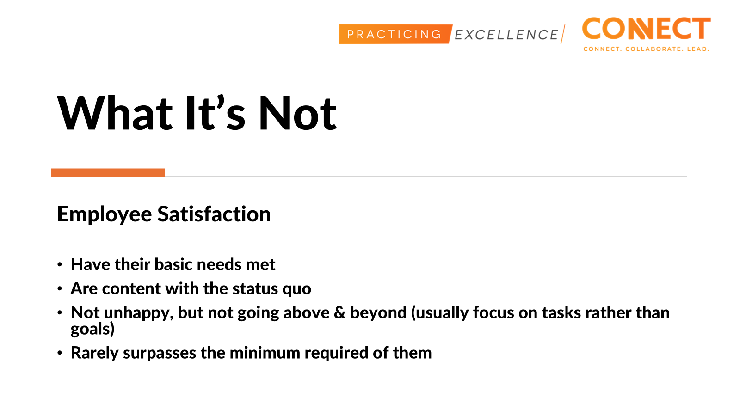
Notes:
MIDDLE OF THE ROAD. Satisfaction is defined as enjoying a state of comfort
Where employee engagement is about being driven by a connection to the work, employee satisfaction is about how closely the job is aligned to the employee’s preferred work environment. Satisfaction is like a 5 rating but engagement is like a 10 rating.

Slide 8
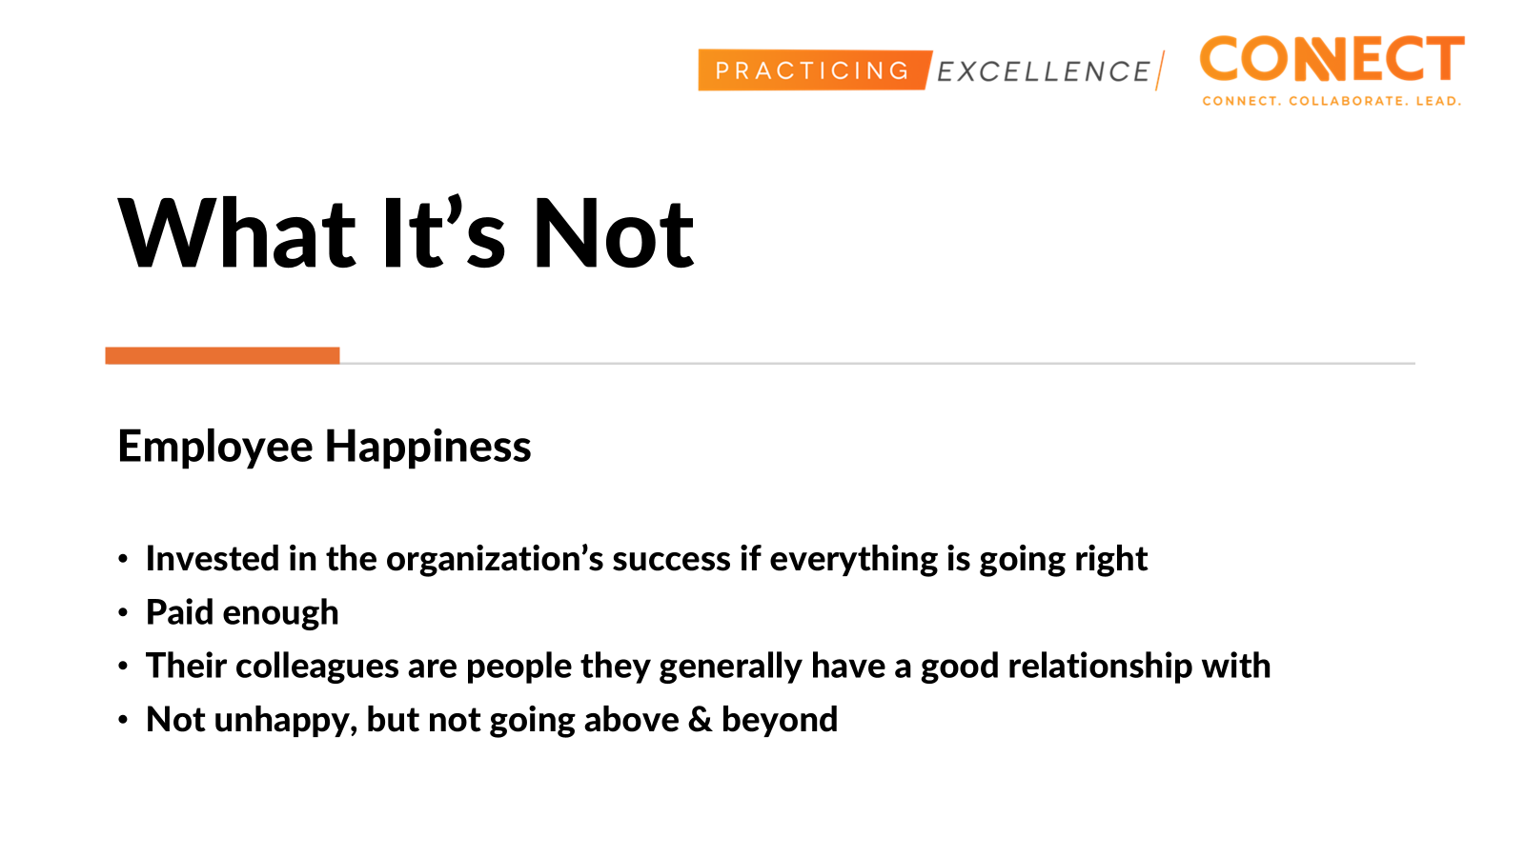
Notes:
People can be happy and not engaged.
Surface level satisfaction, can be influenced by external factors (relationships, benefits, fun workplace culture)
You need engagement at work to achieve happiness…. just like yeast is not bread but it is required to make bread

Slide 9
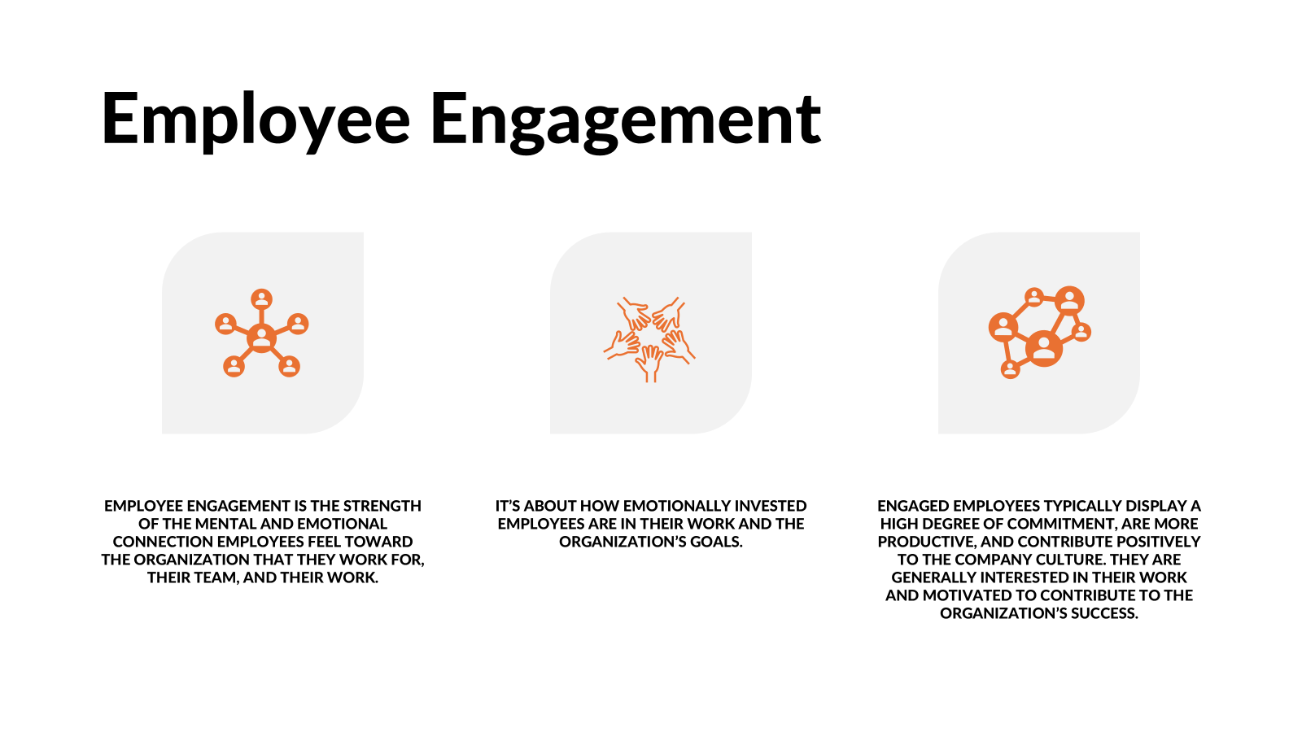



Slide 10
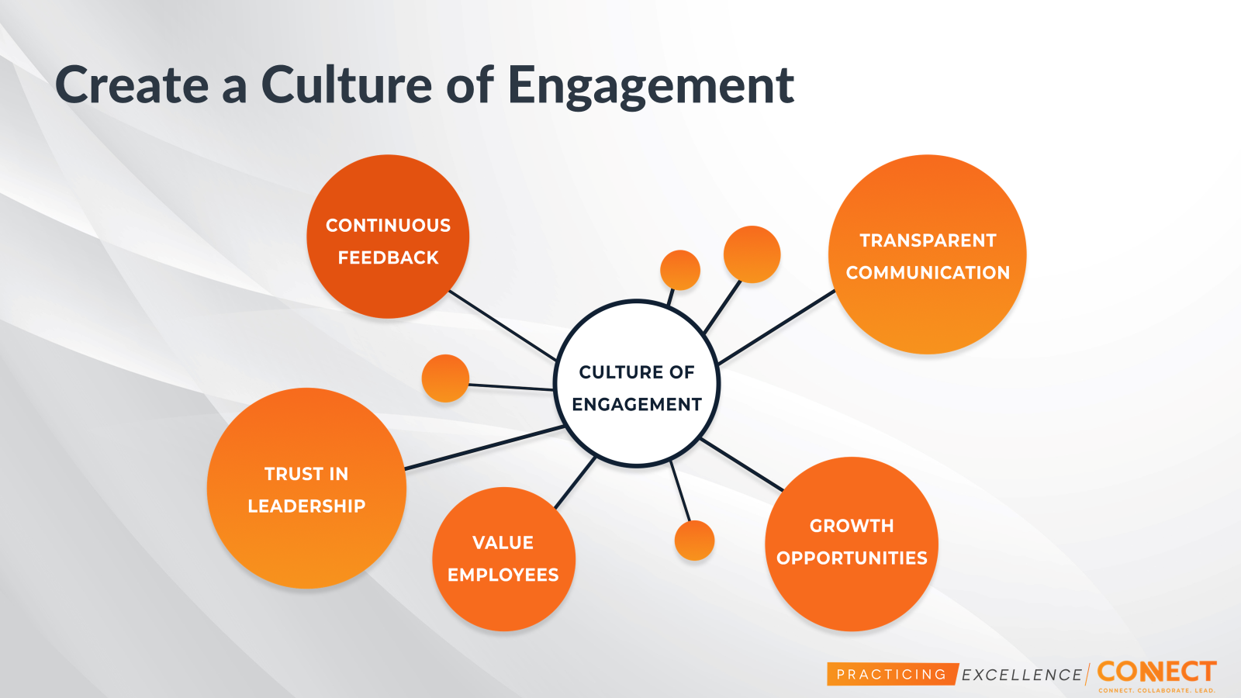

Slide 11
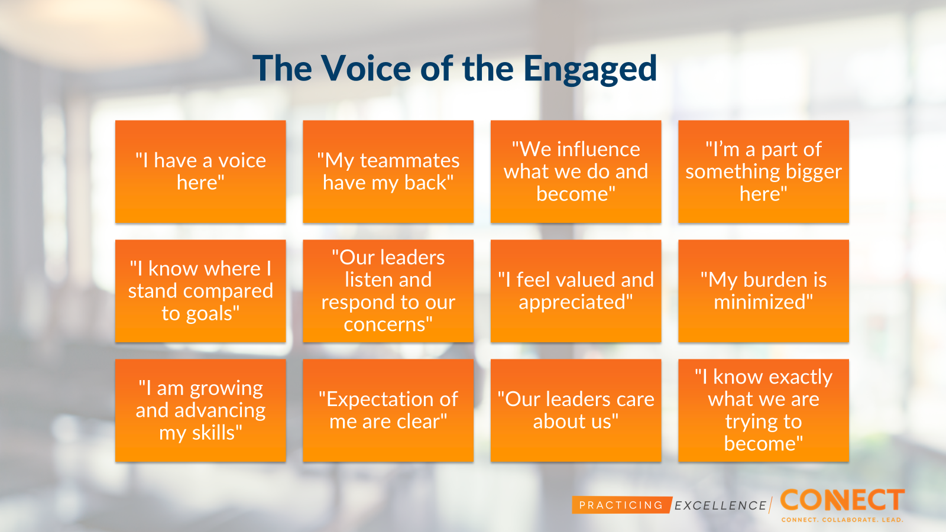

Slide 12
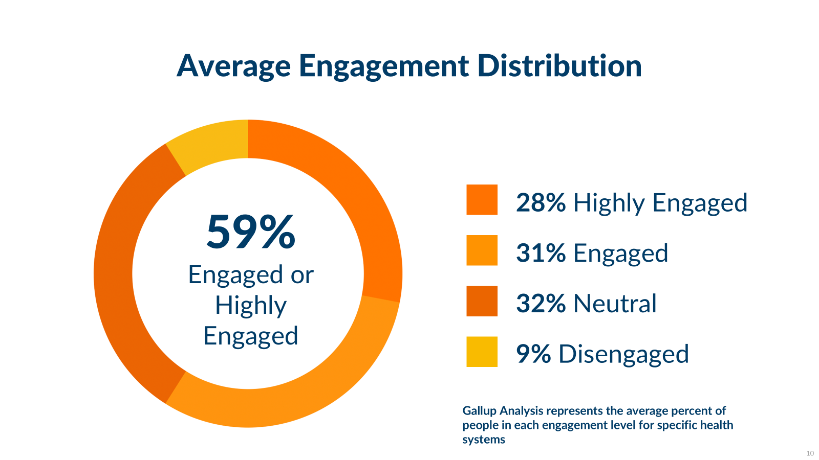
Notes:
While 59% is not tragic, it is a signal to evaluate and enhance our efforts around employee engagement
We are leaving a lot on the table, missed opportunities for innovation, improvement, lower turnover

Slide 13


Notes:
We would say that a 41% failure rate in lighting would create an environment that feels very unsafe and unproductive.

Slide 14
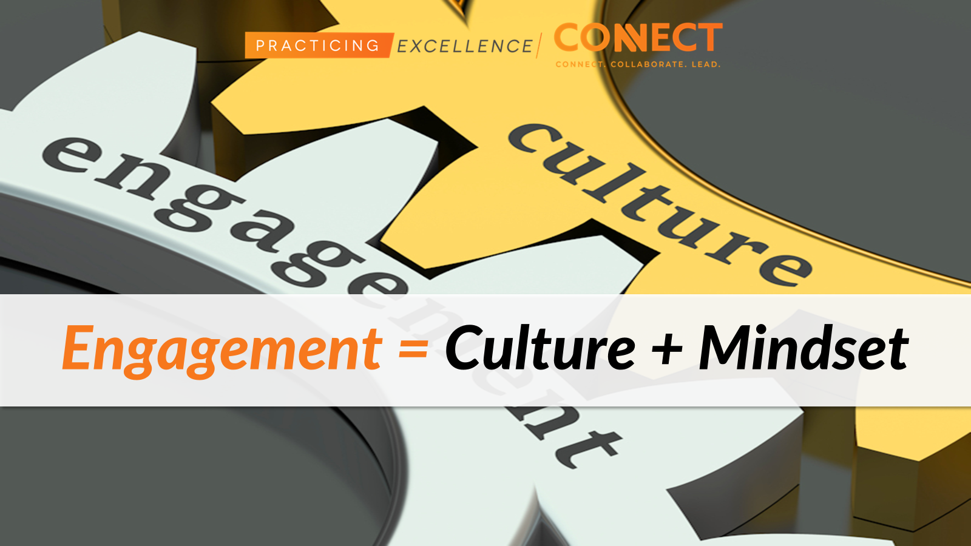
Notes:
Engagement is dependent on 2 things 1) our CULTURE and 2) our MINDSET

Slide 15

Notes:
Innovative, Collaborative, Trusting, Learning, Positive, Transparent
Company culture covers how people communicate, collaborate, and generate ideas. It is the culture of the organization which extracts the best out of each team member. ALIGNMENT is KEY for culture…connecting the employee to the visiob/mission

Slide 16

“Vision without action is merely a dream. Action without vision just passes the time. Vision with action can change the world.”
~Joel A. Barker
Notes:
You have to have both… a clear vision and a passionate sense of purpose Vision + Action changes things!!!
Mindless action can result in the repetition of familiar
Lots of planning but nothing gets done. Rushing around trying to get things done, but no real plan.

Slide 17
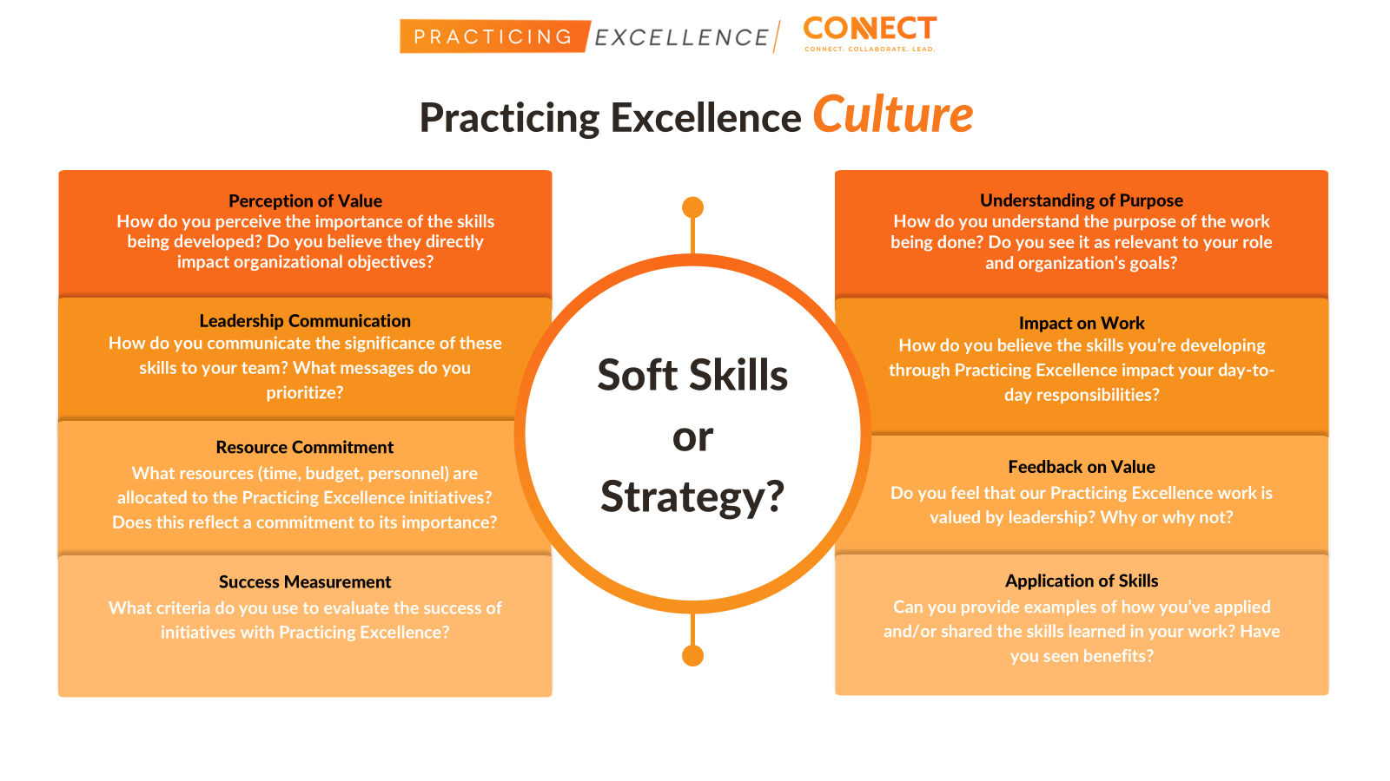

Slide 18


Slide 19
“The way we think about learning can change the way we do it.”
~unknown
Notes:
Conditions have to be right to change the brain and thought process
Speaks to the power of our thoughts and beliefs in determining our actions and outcomes

Slide 20
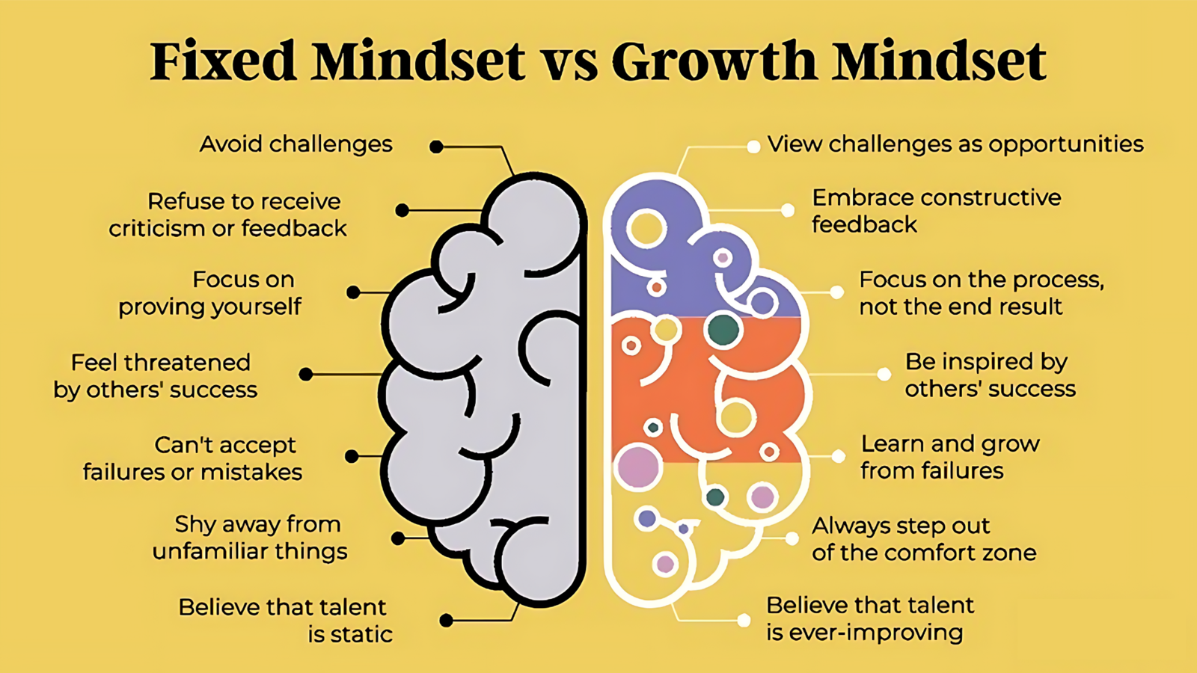
Notes:
Carol Dweck
A growth mindset is the foundation for learning
If we understand this, no matter what we build, from this foundation it will always be more powerful
THIS IS HOW you build a great culture for learning that pours into and builds that great ENGAGEMENT we want.

Slide 21
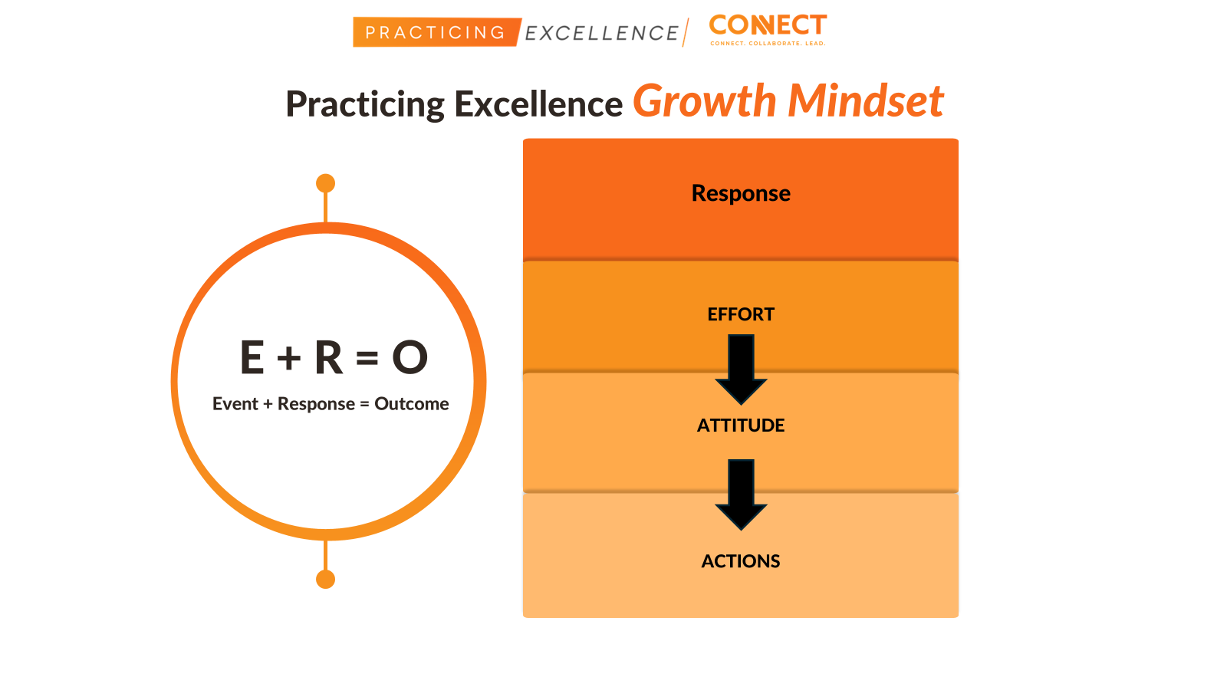

Slide 22
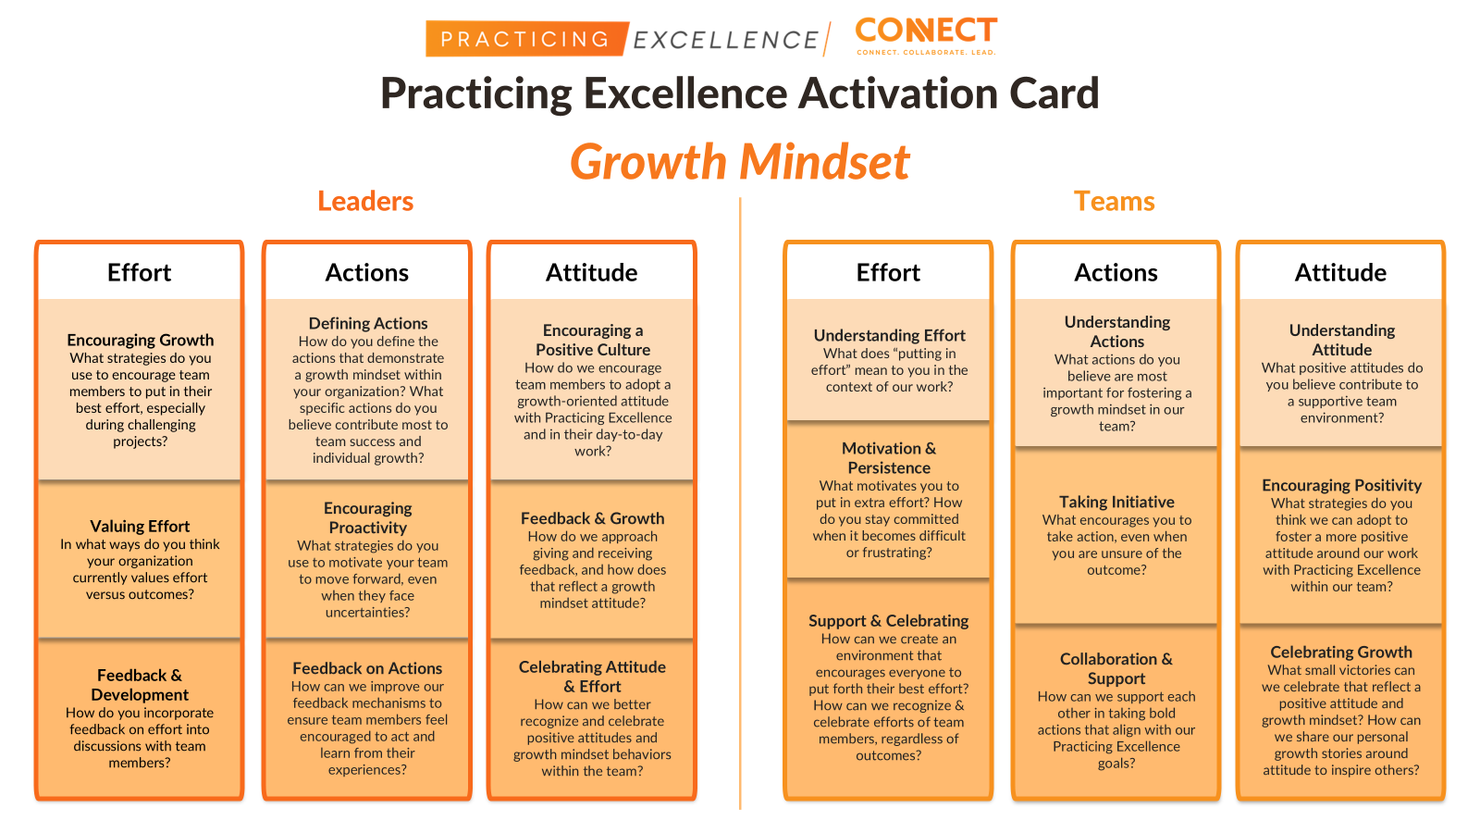

Slide 23

The “Art” of Engagement
Notes:
Reminder of resource to fill out

Slide 24


Increased Productivity
Better Problem Solving and Innovation
Enhanced Quality of Work
Greater Resilience
Improved Team Dynamics
Employee Retention
Positive Organizational Culture
Adaptability and Change Management
Personal Growth and Development
KEY REASONS WHY ENGAGEMENT IS VITAL
Notes:
The importance of engagement in achieving outcomes cannot be overstated. Engagement is a critical factor that directly impacts an individual's or a team's ability to attain desired results. Here are some key reasons why engagement is vital in achieving outcomes:
Increased Productivity: Engaged individuals are more motivated and enthusiastic about their work. This heightened sense of purpose and commitment often leads to increased productivity and efficiency.
Better Problem-Solving and Innovation: Engaged employees or team members tend to be more creative and innovative. They are more likely to think outside the box, find solutions to challenges, and contribute fresh ideas.
Enhanced Quality of Work: When people are engaged, they take greater pride in their work. This focus on excellence often results in higher-quality output and a commitment to delivering superior results.
Greater Resilience: Engaged individuals are more resilient in the face of setbacks or obstacles. They are willing to persevere and adapt to overcome challenges, which is essential for achieving long-term goals.
Improved Team Dynamics: In a team setting, engagement fosters better collaboration and cooperation. Engaged team members are more likely to communicate effectively, support one another, and work harmoniously toward a common objective.
Employee Retention: Engaged employees are more satisfied with their work and are less likely to seek employment elsewhere. This not only reduces turnover costs but also ensures that valuable experience and expertise remain within the organization.
Positive Organizational Culture: Engagement contributes to a positive organizational culture where values, vision, and mission align with the goals of the team or company. A strong culture, in turn, attracts top talent and fosters a sense of belonging and purpose.
Adaptability and Change Management: Engaged individuals are more open to change and more adaptable. They can more readily embrace new strategies and technologies, which is crucial in rapidly evolving industries.
Personal Growth and Development: Engagement often encourages individuals to invest in their own growth and development. This personal growth can result in a more skilled and knowledgeable workforce that is better equipped to achieve desired outcomes.
Engagement is the driving force that can turn a group of individuals or a team into a high-performing, motivated, and committed unit. It is the catalyst for achieving outstanding outcomes, both on an individual and organizational level. Engaged individuals bring their best selves to their work, and the ripple effect of their commitment can lead to transformative results in any field.

Slide 25






STRATEGIES TO FOSTER ENGAGEMENT
Effective Communication | Empowerment | Recognition & Reward | Professional Development | Inclusivity
Notes:
STRATEGIES TO FOSTER ENGAGEMENT
Highlight a few key strategies to promote and foster engagement:
a. Effective Communication: Emphasize the importance of clear and open communication to keep team members informed and connected.
b. Empowerment: Encourage team members to take ownership and make decisions, fostering a sense of responsibility and pride.
c. Recognition and Reward: Discuss the value of acknowledging and rewarding individual and team contributions.
d. Professional Development: Explain how investing in the growth and development of team members can boost engagement.
e. Inclusivity and Diversity: Discuss the role of inclusivity and diversity in creating an engaged and motivated workforce.

Slide 26





Engagement Best Practices
Leading with Practicing Excellence
Communication
Reward and Recognition

Slide 27


Leading with Practicing Excellence

Slide 28

Leading with Practicing Excellence
Leaders first and always!
Use a message of continuous development and shared purpose
Prioritize adaptability to adjust and align to new goals, objectives, or organizational strategies
Sustainment begins with leaders
Notes:
JH
System – town halls, all provider meetings
Virtual
Digital
Communication strategy?
Reward and recognition?

Slide 29

Introduce PE at monthly/quarterly leadership meetings each time you have a new program, special launch, or new strategies to share with other leaders.
Identify which leaders are early adopters. How can you tap these leaders to share their stories of impact?
What PE materials will be given to leaders? Resource Bundles, reporting tools, toolkits, engagement ideas resources?
How will leaders access PE support materials? Will you utilize your organization’s intranet, SharePoint site, etc.?
Leading with Practicing Excellence

Slide 30

Communication Strategies

Slide 31

Communication works
for those who work at it.
John Powell

Slide 32

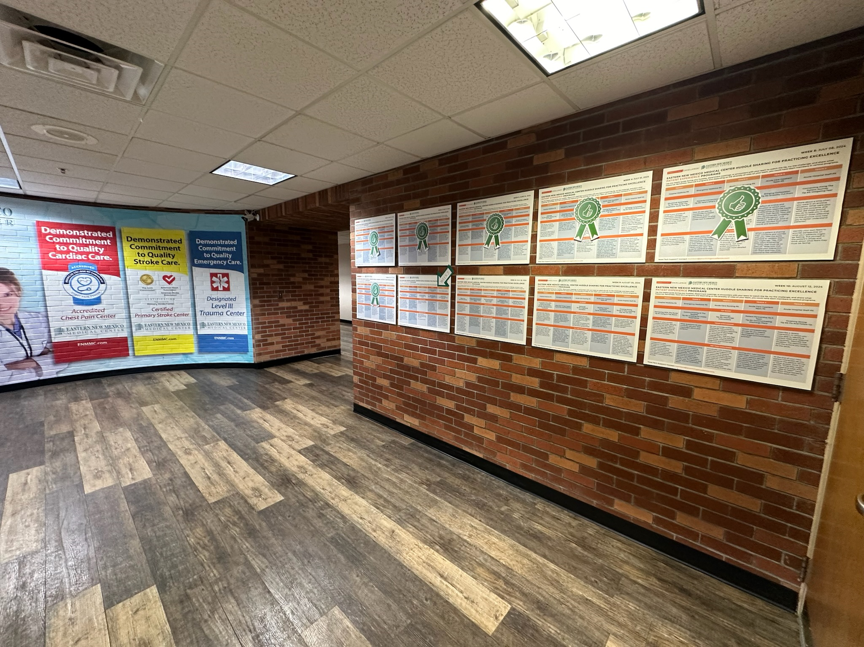

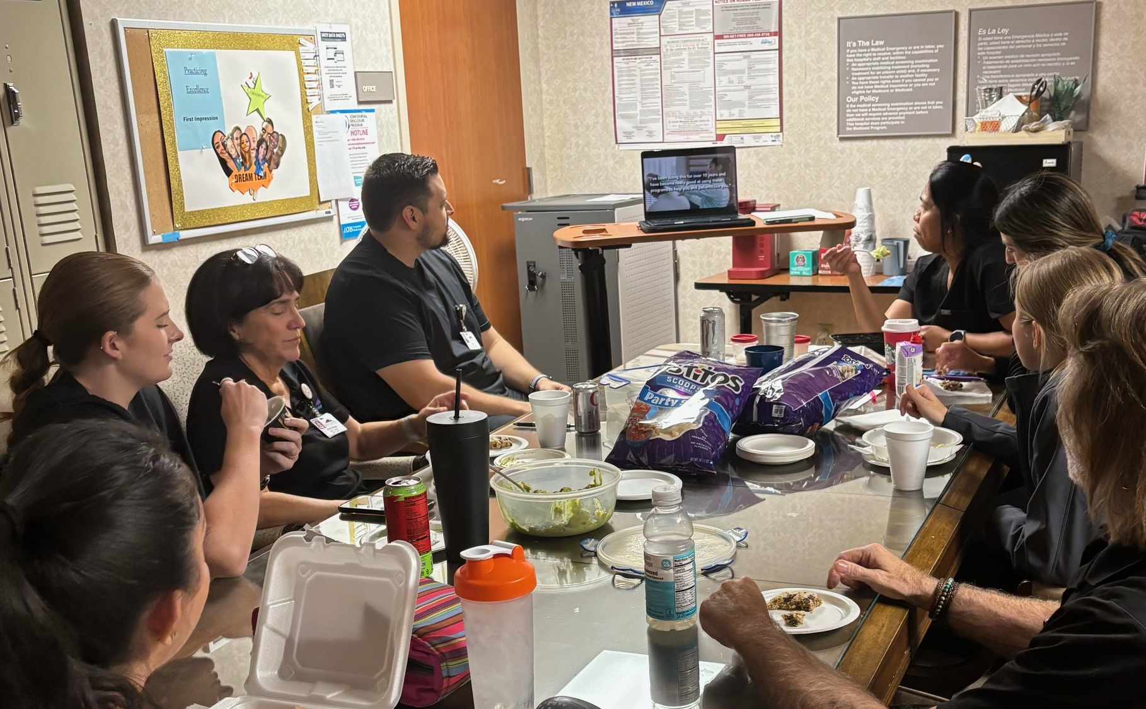
Communication Strategies
Consider methods that work best for your teams. How do they prefer to receive information?
Identify when and how to share recommendations of content.
(Email, Text, Intranet, Flyer Usage, etc.)
Include a direct link to the tip in all relevant communications.
Share personal and colleague stores of impact from viewing tips and putting the tips into action.

Slide 33


Reward and Recognition

Slide 34
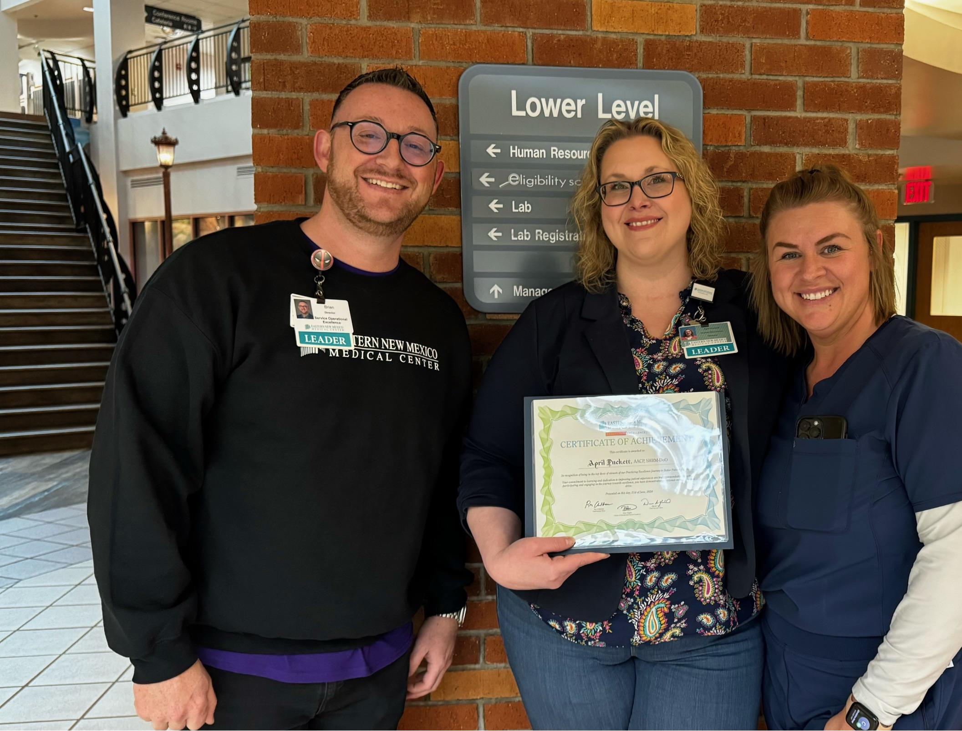
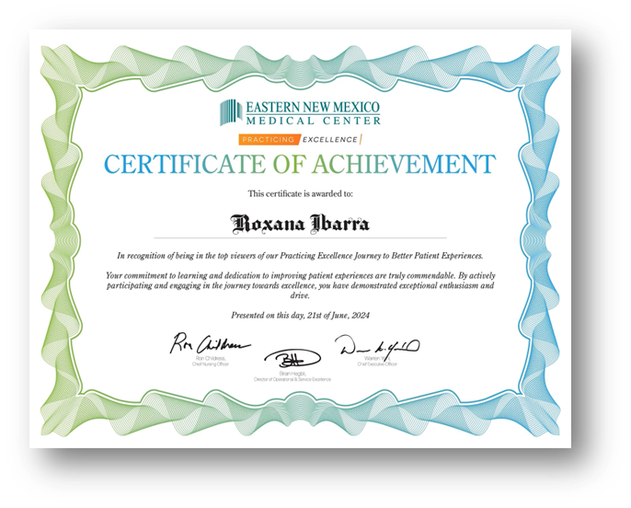
Reward and Recognition
Have your feedback be specific and personal.
Recognition should be timely and consistent for members of the team.
Utilize diverse recognition methods (verbal, written, public recognition, etc.)
Incorporate both team-based and tangible rewards
i.e. certificates, group celebrations, a mention on a recognition board, etc.

Slide 35

Activation

Slide 36

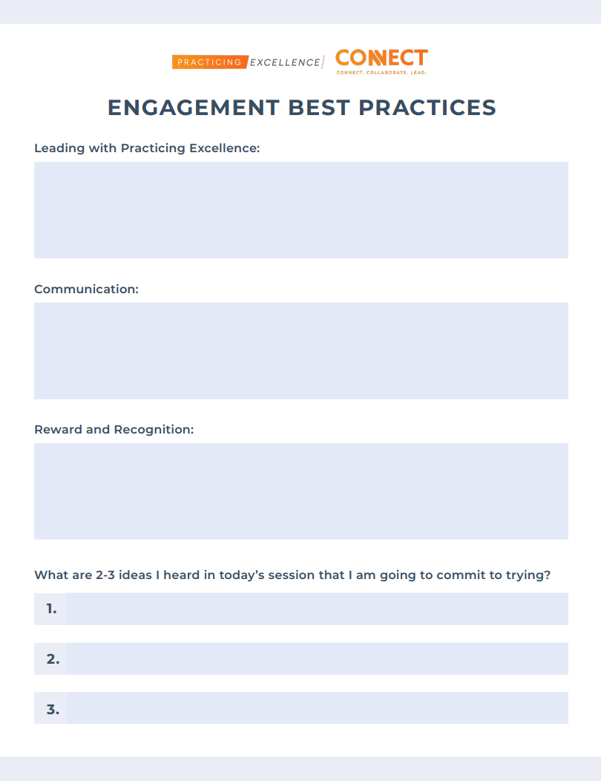
Using PE to support your teams
Breakout Planning Instructions
Using your Engagement Ideation handout:
Step 1: Share one way you plan on Leading, Communicating, and providing Recognition and Reward to your team regarding engagement with PE.
Step 2: Select a notetaker/spokesman for debrief time.
Step 3: Begin capturing your team’s thoughts. Capture your three best ideas to share with the group.

Slide 37

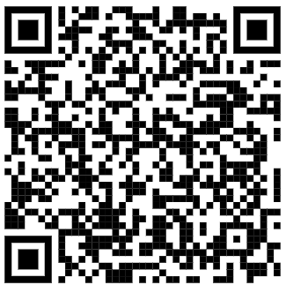
Next Steps and Resources
Continue engaging your team with your
PE Growth Mindset Activation Card!
Meet with your PE project team, and discuss one idea from leading with PE, communication, and reward and recognition that can be implemented within your organization.
Review the provided resources from today’s session and share with others!
Reach out to your CS Team with any questions!
Session Resources

Slide 38
Thank you for attending!
Let’s continue the conversation…

