Slide 1



Human Development:
Getting Results on Your Goals
STEPHEN BEESON, MD
FAMILY MEDICINE PHYSICIAN
FOUNDER OF PRACTICING EXCELLENCE

Slide 2


GOALS FOR TODAY
Hear stories of how partners implement human development strategies to help organizations better connect, collaborate, and lead.
Explore how human development serves as a catalyst to unify priorities, engage teams, and accelerate outcomes.
Discuss challenges scaling human development and countermeasures to drive adoption, value, and impact.

Slide 3


OUR APPROACH
Continuously building skills to power the capacity of people to achieve results.

Slide 4


CURRENT STATE
FUTURE STATE
PEOPLE DEVELOPMENT

Slide 5

THREE BASIC ACTIONS
TO DRIVE RESULTS WITH
HUMAN DEVELOPMENT

Slide 6

ACTION 1:
LED BY LEADERS
The presence, voice, example and advocacy of leaders is the single greatest predictor of a human development strategy success.

Slide 7

LED BY LEADERS' ACTIONS
Leaders see and believe in the power of human development to achieve goals
Leaders go first in participation in leadership development
Leaders champion and communicate the future state
Leaders share what they are learning and doing

Slide 8
Assessing Your Leadership of a Human Development Strategy (Slido)
1: Leaders got PE for teams to improve metrics and are not participating themselves. No clear goals or communications of organizational intentions
2: Leaders are participating lightly; goals are formulated but not clearly communicated
3: Leaders are participating but not modeling nor sharing what they are learning. Minimal communication of future state goals
4: Leaders are participating in a meaningful way. There is clear communication of goals
5: Leaders are all certifying. Passionate communication of intent by managers and above. Clear modeling of leader developed behaviors
Notes:
Slido – leave

Slide 9

CALL OUT
How have leaders where you are led a human development strategy?

Slide 10

ACTION 2:
MAPPING OF HUMAN
DEVELOPMENT TO GOALS
For a goal to be achieved… we must do the behaviors that manifest your goal

Slide 11

IDEAL HUMAN DEVELOPMENT DEPLOYMENT
Determine goal/s
Define success measures
Enroll leaders (Bootcamps/ workshops)
Develop communication plan
Leader modeling/ storytelling
Broad launch of
skill-building programs
Share stories from early adopters
Recognize skill application
Progress tracking

Slide 12

GOAL SELECTION BEST PRACTICES
This is not about Practicing Excellence and “watching coaching tips”…it is about achieving your future state goals
As the process demonstrates outcomes, share progress to demonstrate credibility of skill development approach
Look at strategic dashboard to determine additional people development programs to accelerate improvement

Slide 13

COMMON PRACTICING EXCELLENCE
COMMUNITY GOALS
Patient Experience
Safety Culture/HRO
Leadership Development
Safety Culture/HRO
Access Optimization
Health Equity
Residency Programs
Team Collaboration
Value-Based Care

Slide 14

CALL OUT
What Big Goals are you mapping human development to?

Slide 15

CALL OUT
What new priorities or challenges are emerging where a people development strategy can help?

Slide 16

CALL OUT
How are you defining success of a human development strategy?

Slide 17

ACTION 3:
APPLY MULTI-LEVEL
SKILL DEVELOPMENT
A mastery culture is about applying development to raise the capacity of people to create results

Slide 18

OUR APPROACH
Build A Continuous Human Development & Improvement Engine
ORAGNIZATION
TEAMS
INDIVIDUALS
Notes:
This is not a cycle…should be more stacked like the other slide we have like this

Slide 19

ORGANIZATION LEVEL GLOBAL PROGRAMS
Mapped to big goals
Often includes certifications
Unifies teams
Patient experience, team collaboration and safety are common examples

Slide 20

TEAM LEVEL APPLICATIONS
Using local team challenges and intentions to develop local teams
Local leaders know how to use tips and skills to take on local challenges
Group learning and content sharing is common
Learning forums are used
Flipped classroom

Slide 21

INDIVIDUAL LEARNING
Individual self-guided learning on areas of challenge or interest is critical element of a learning culture

Slide 22

BIG TAKE HOMES
Leaders leading the way with influence, communication and modeling is critical to success
Widen the aperture of human development to map to big and smaller goals
Look to integrate human development globally, at team levels, and for individuals

Slide 23

A FINAL CHALLENGE:
LEADERS LEADING HUMAN DEVELOPMENT
Reflect on your big global goals
In this Final Challenge we will do TWO THINGS
  Assess leader participation in a Human Development Strategy
  Outline actions to raise the impact of leaders leading the way

Slide 24
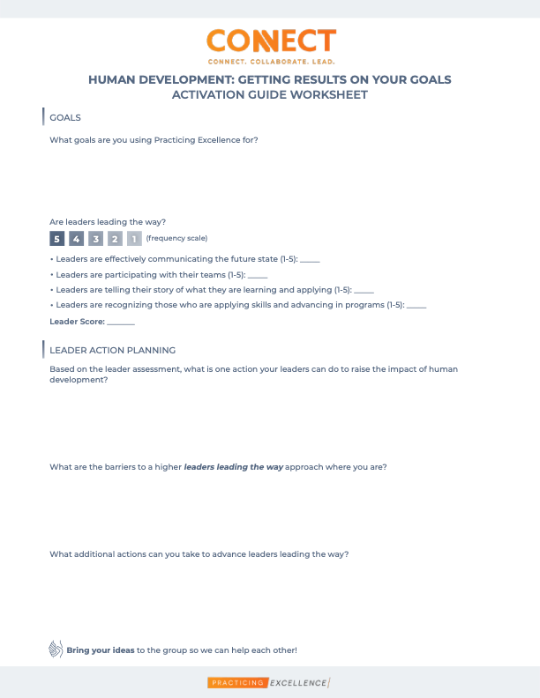
BREAKOUT ACTIVITY
Please use the activation guide worksheet for this breakout and complete the questions

