Slide 1




W
LEADING TO ENGAGE
WORKSHOP
BLAINE BRACKETT
SENIOR DIRECTOR, CLIENT SUCCESS
SAM HICKERT
PROGRAM MANAGER

Slide 2




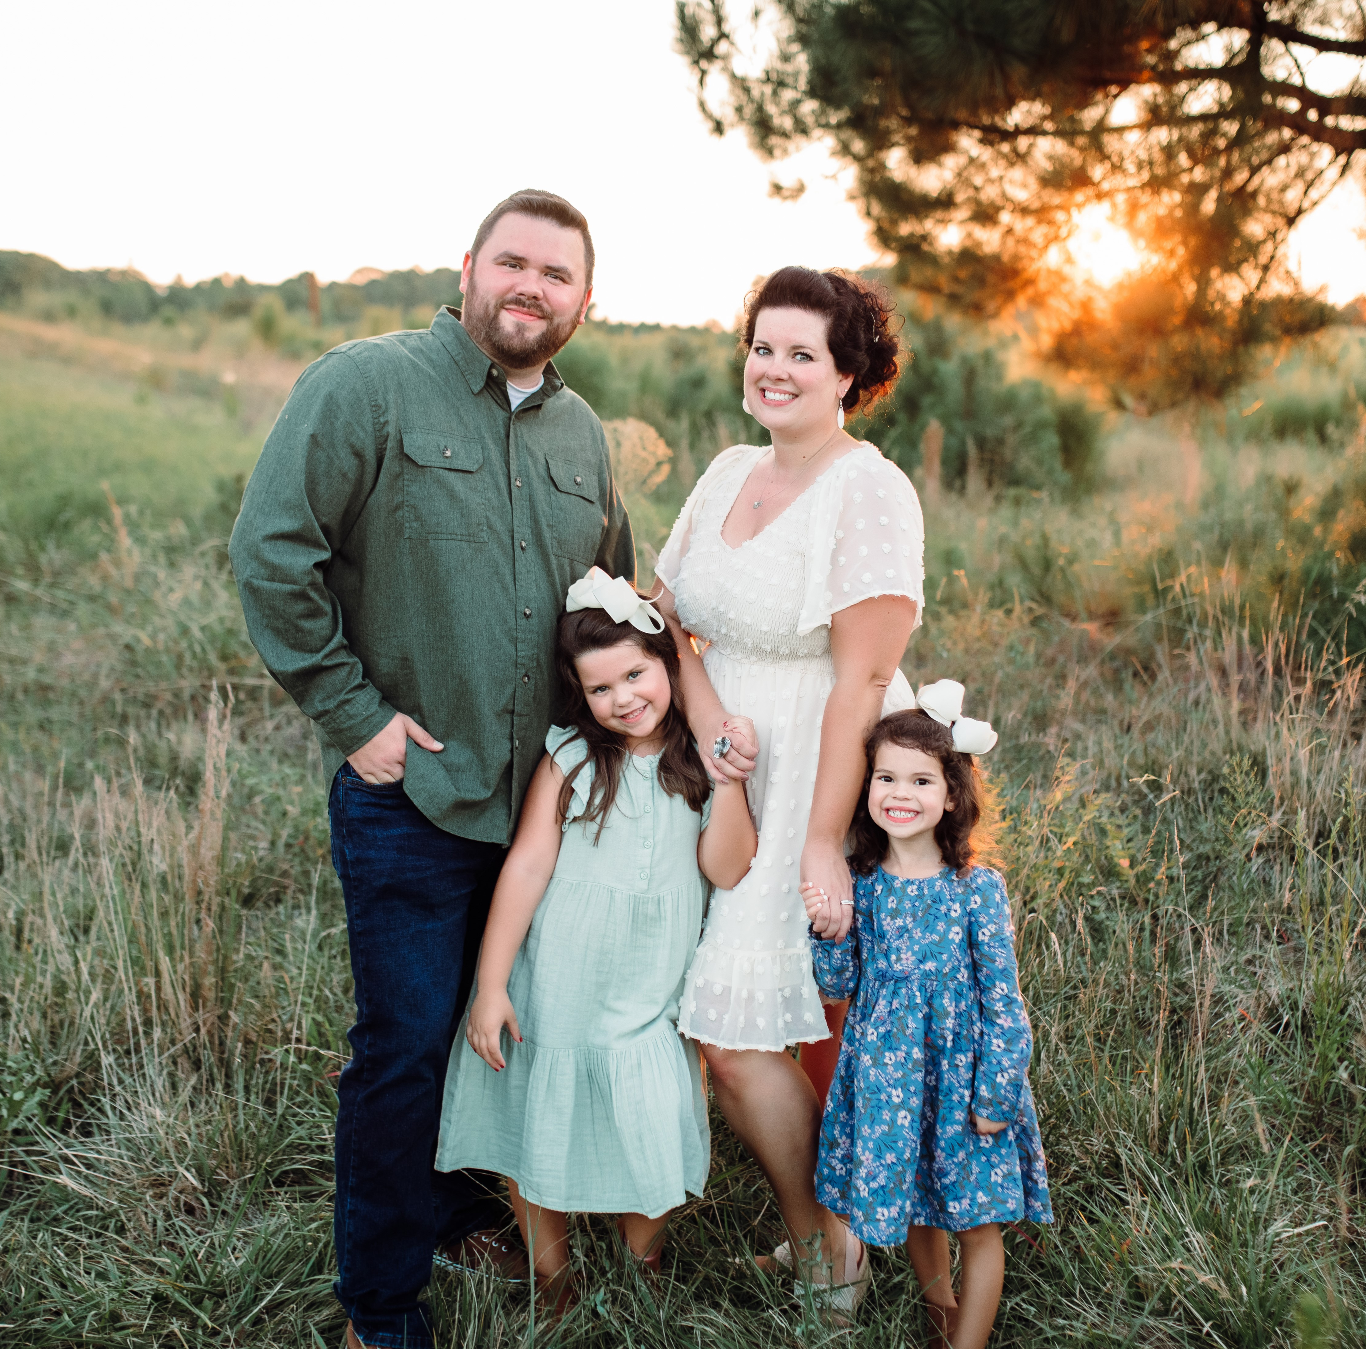
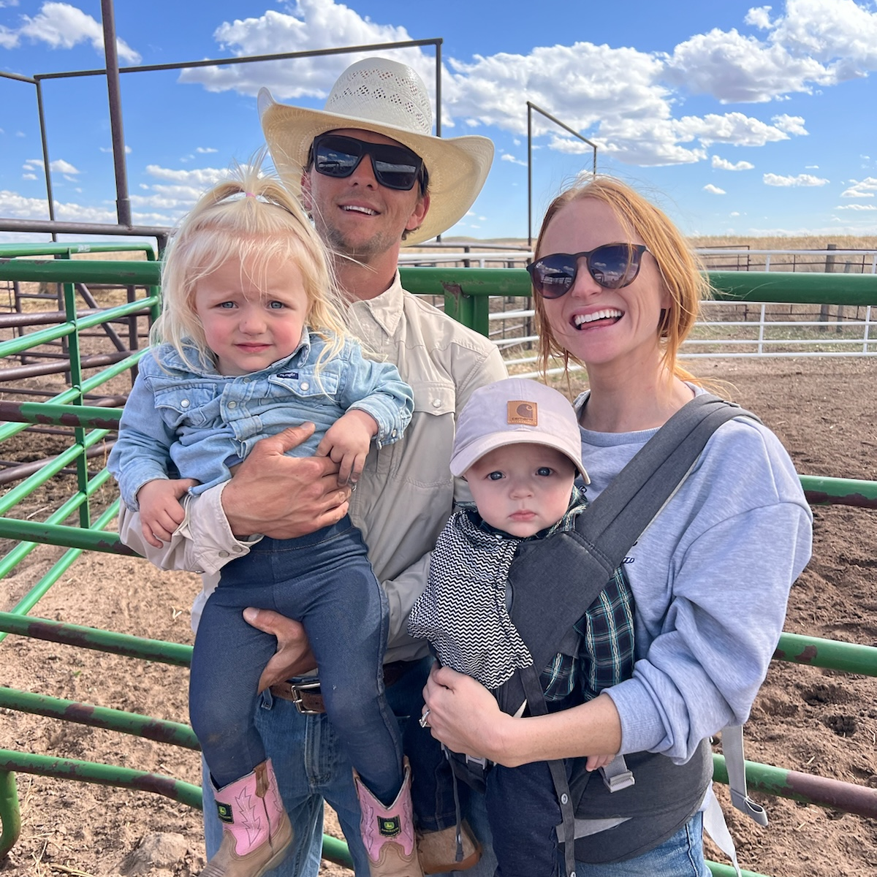
Husband
Dad
Grill Master
Doodle Dad
Softball and Cheer Dad
Wife
Mom
Household COO
Ranch Hand
Party Planner
BLAINE BRACKETT
Sr. Director, Client Success
SAM HICKERT
Program Manager

Slide 3

Engagement:
The Catalyst for Excellence

Slide 4
ENGAGEMENT DEFINED
“I’m staying here…”
“I would recommend this place to my colleagues and friends…”
“I will access my discretionary effort to help this place succeed…”
“I will use my influence to engage those around me to pursue our purpose…”
“This is everything I hoped for…”

Slide 5


SENTIMENTS OF ENGAGEMENT
I'm proud of who I am and the group I am part of
The quality of my work life matters here
I feel a sense of belonging
My voice is heard
I feel valued
I am being the person I wanted to be
I see my future here
I feel like I make an impact
I am growing and advancing in things that matter to me
I can step away from work and engage in other things and people
Leaders have my back
The purpose we serve is bigger than us

Slide 6

HOW’S THAT GOING?
Approximately 20% of care team members are actively engaged.

Slide 7

WHAT WE KNOW?
70% of a team’s engagement is directly related to the individual who leads them.

Slide 8


WHO LIT YOUR FIRE?
Notes:
"Think of someone in your professional life who really lit your fire. What did they do that sparked your motivation and drive?"

Slide 9

A Reflection and
A Challenge…
Whose fire are you lighting?
Turn to page 1 in your activation guide and record your thoughts

Slide 10
W
LEADING TO ENGAGE
CERTIFICATION PROGRAM
Notes:
This is such a stella program – I’m really, really impressed with the content. It’s cutting edge stuff that leadership experts are just starting to talk about more mainstream, I can guarantee there are ideas in there you haven’t yet explored, even if you are the most senior leader and it’s available right now in the app.

Slide 11
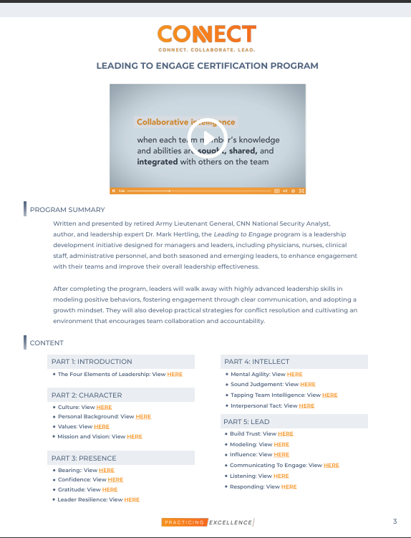
LEADING TO ENGAGE CERTIFICATION PROGRAM
Part 1: Introduction
Part 2: Character
Part 3: Presence
Part 4: Intellect
Part 5: Lead
Notes:
There are currently 5 parts of the program

Slide 12
LEADING TO ENGAGE CERTIFICATION PROGRAM
Part 1: Introduction
Part 2: Character
Part 3: Presence
Part 4: Intellect
Part 5: Lead
Part 6: Develop (Q1 2025)
Part 7: Achieve (Q1 2025)
Notes:
With Part 6 and 7 will be released in 2025

Slide 13

MARK HERTLING
RETIRED ARMY LIEUTENANT GENERAL
Lead Faculty: Leading to Engage Program
CNN National Security Analyst
Author of Growing Physician Leaders
Advent Health, SVP of Global Leadership
Practicing Excellence Lead Faculty Member,
Physician Leader Development
Notes:
MARK HERTLING, DBA
Retired Army LTG, CNN National Security Analyst Author of Growing Physician Leaders
To know this guy is truly to love him.
Mark Hertling is a retired lieutenant general who served in the United States army for 38 years, You may have seen him on TV as he is currently both a national security and military analyst for CNN and adjunct professor at Crummer Graduate School of Business at Rollins College.
He has been a leadership development designer and training for various healthcare organizations, and has focused on coaching healthcare professionals to become better leaders. Over the span of his career, he has held the position of Global Strategy and Leader Development at AdventHealth, authored the book Growing Physician Leaders to transform healthcare through physician leadership, and served as an appointee to the U.S. President's Council on Fitness, Sports, and Nutrition.
His passion is to support leaders in their learning journey and influence them to achieve their goals.

Slide 14
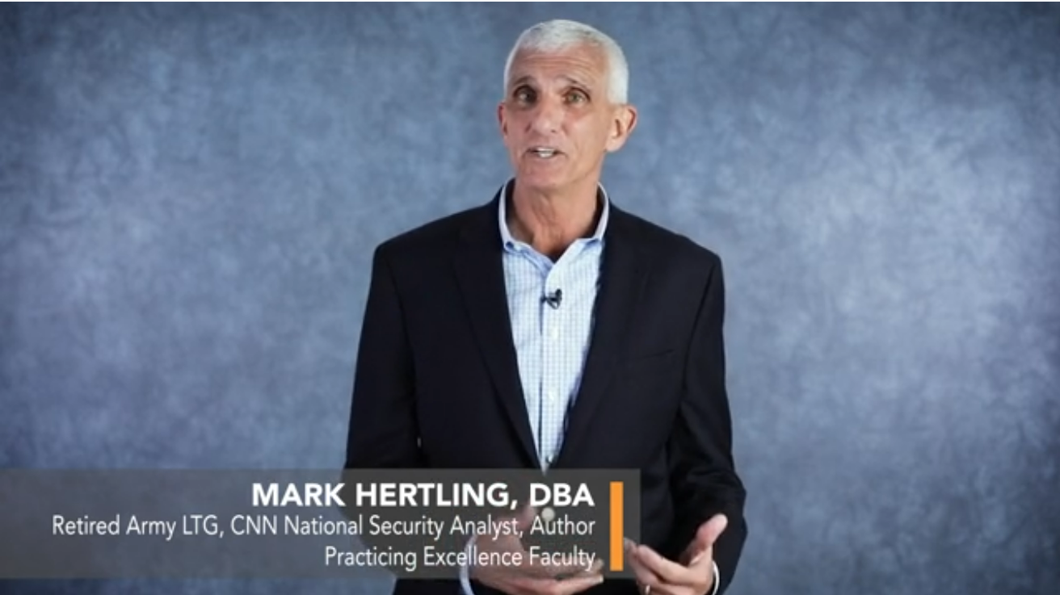

CHOOSE TIP TO WATCH
Notes:
Chrisie So let me share our Practicing Excellence kick off video.

Slide 15


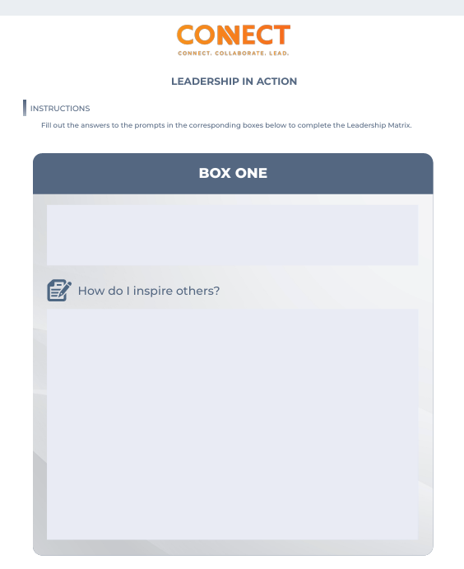
Let’s get started!
Leadership in Action
Turn to page 4 of your Leading To Engage Activation Guide
Notes:
Today we’re going to use the resources and ideas from Mark and the Leading To Engage Certification Program to do some self reflecting, a little bit of sharing and then give you resources and ideas that even if you implemented one today, I promise you you will see an impact in how you show up as a leader. So let’s get to work.
Do me a favor and turn to page 4 in your activation guide: fINAL-Leading-to-Engage-Activation-Guide.pdf

Slide 16

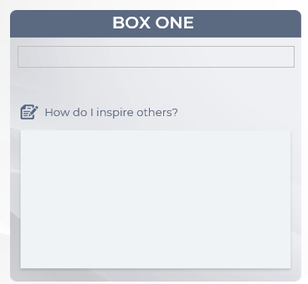
How do I inspire others?
Fill in your answer in Box 1 on page 4of your Activation Guide.
Notes:
You’re going to see a prompt there How do I inspire others. Take 30 seconds right now and write down your thoughts. You can type this directly into the guide.
And when you think about that word inspire
It's not just about telling people what to do - it's about painting a picture of what's possible that gets people excited to jump in.
It's like connecting the dots for people - helping them see how their daily work fits into something bigger and making them think 'Hey, I can actually do this! What I do here matter!' When you tap into what truly drives people - their hopes, values, and aspirations - that's when they bring their full energy and creativity to the table."
It’s about making someone want to climb a mountain – maybe because they have seen you do it and have instilled within them that you can too.

Slide 17
HOW DO I INSPIRE OTHERS?
Unmute and share what you wrote!
Notes:
Have the group come off of mute and share plus use the chat

Slide 18

How do I inspire others?
LEADERSHIP HABITS TO START TODAY
Notes:
We asked you how to do you inspire others?
Those answers you see in your box and we just discussed, these are leadership habits that you do daily – these are what make you unique as a leader and you can’t lose sight of these when you get stressed, when you get busy, when a challenge pops up. Go ahead and on that same box, you can type LEADERSHIP HABITS TO START TODAY. We’re going to repeat this exercise three more times but before we do, it’s so important that you walk away with tangible tools you can use to form these inspirational leadership habits.

Slide 19
01
LEADERSHIP HABITS TO START TODAY
Workbook Support:
Link individual contribution to the success of the team.
“What is something you want fixed that’s not getting enough attention from me?”
Lead by an overexaggerated example.
“Becoming a Grateful Leader” actions.
Set short-term wins and recognize and celebrate small victories.
Pulse check psychological safety on your team.
Notes:
Here are some you take today!
Link individual contribution to the success of the team – help each team member see how their work fits into the overall mission
Lead by overexaggerated examples - Demonstrate the behaviors you want to see, and be the best at them – if you want your team to bring a positive attitude to work, you better bring the MOST positive outlook to work. If you want your team to put their family first, they better see you making an exaggerated effort to put yours first and work second
Set Short-Term Wins – and celebrate small victories – an inspirational leader Create momentum by setting goals that can be achieved today or within the week, helping the team feel a sense of accomplishment quickly. Celebrate these small victories to keep morale high and you will maintain momentum toward larger goals. Recognize people in meaningful ways – I grabbed you a coffee this morning because I realize that we talked about getting our charting done before 5:00 and I can tell yesterday you made the effort and got it done!
Now when you see the bullets under workbook support, these are pulled from a LTE workbook that we’ll give you access today and also pulled out so they are handy and easy to use today in your AG
Listening – Determining Team Moral and Finding your Teams needs
Part 5 lead: Understanding motivation
Modeling behaviors
Spreading good ideas
Optimism and hope
Link all of these

Slide 20
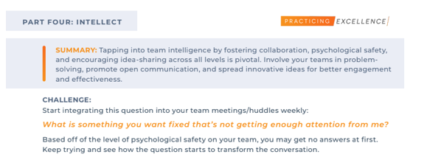
“What is something you want fixed that’s not getting enough attention from me?”
Page 8 of your Activation Guide
Notes:
So first up. Start integrating this into your weekly or daily huddles – what is something that you want fixed that’s not getting enough attention from me?
Based off the level of psychological safety you might get no answers at first, but keep trying and see how this question starts to transform the conversation.

Slide 21
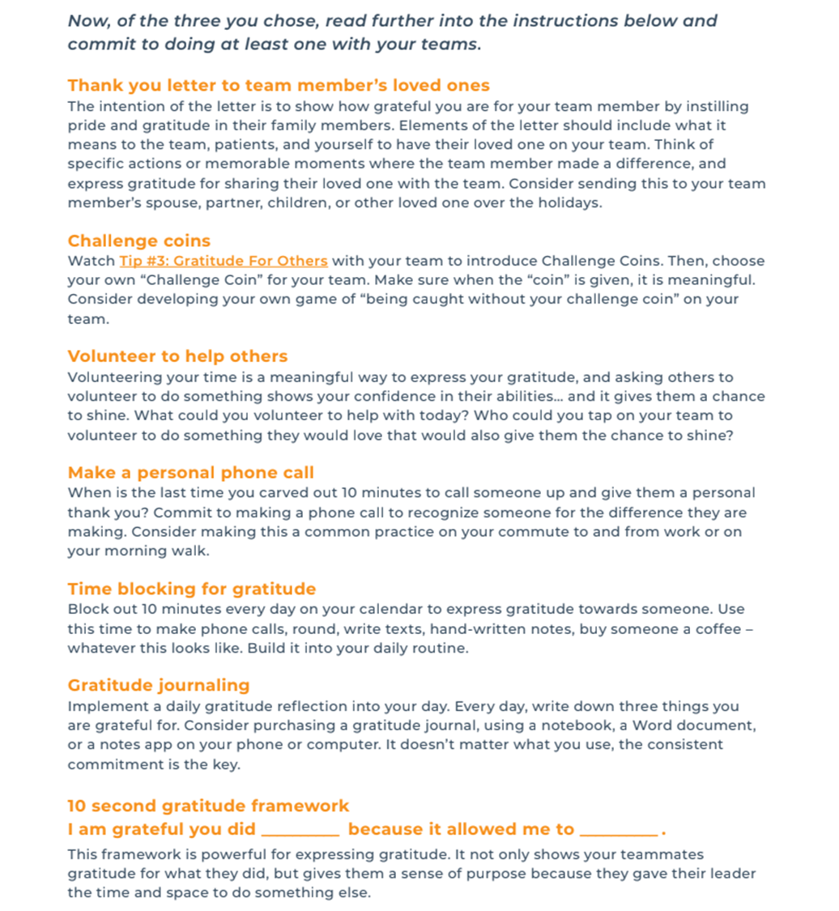
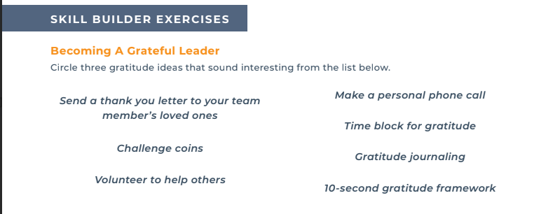
“Becoming a Grateful Leader” actions.
Page 9 of your Activation Guide
Notes:
Becoming a grateful leader. Inspirational leaders express gratitude OFTEN. I’m sure you have your go tos and we’ve given you a list that hopefully gives you some new ideas.

Slide 22
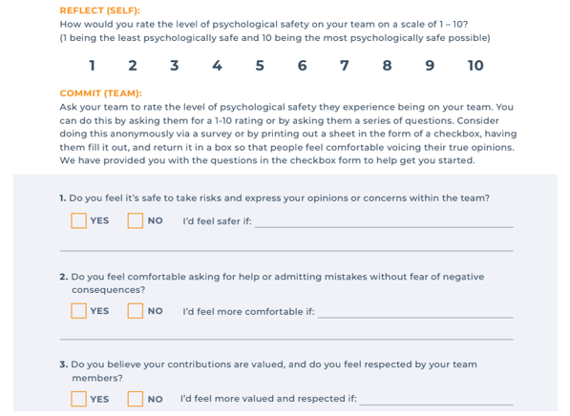
Pulse check psychological safety on your team.
Page 8 of your Activation Guide
Notes:
Psychological safety on your team is crucial for you to be a leader that inspires greatness. I encourage you to pulse check psychological safety on your team. We’ve made it easy by having the questions – load this into a survey monkey or print and have people hand write and drop into a suggestions box. Do this often – at least once a year. You as a leader do not want to let this slip.

Slide 23

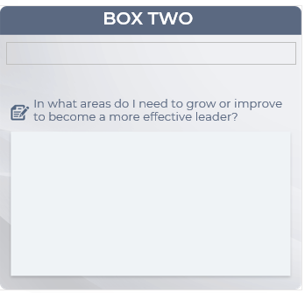
In what areas do I need to grow or improve to become a more effective leader?
Fill in your answer in Box 2 on page 5 of your Activation Guide.
Notes:
Alright turning back to page 5 on your guide we’re going to do some reflection on this question. Take 30 seconds and write down what areas do you need to grow or improve to become a more effective leader?

Slide 24

IN WHAT AREAS DO I NEED TO GROW OR IMPROVE TO BECOME A MORE
EFFECTIVE LEADER?
Unmute and share what you wrote!
Notes:
Have the group come off of mute and share plus use the chat

Slide 25

In what areas do I need to grow or improve to become a more effective leader?
THE ACTIONS THAT ALIGN WITH THE LEADER I WANT TO BE
Notes:
We asked you In what areas do I need to grow or improve to become a more effective leader?
Those answer are the THE ACTIONS THAT ALIGN WITH THE LEADER I WANT TO BE
These are the things that matter to you. That you value. That when you are looking to invest in your own development as a leader for the good of the team you need to turn to

Slide 26
THE ACTIONS THAT ALIGN WITH THE LEADER I WANT TO BE
02
Workbook Support:
Implement one self-development ritual that you do every week, no matter what.
“Level-Headed Leadership Tactics”
Find your strengths and focus on developing them.
“Leadership By Walking Around” (LBWA) Essential Questions
Pull from what you idol.
Leader 360
Notes:
This is long term. The actions we take fueled by the belief we have in ourselves. Inside Out 2 reference. Those beliefs will fuel our actions.
Implement one self-development ritual that you do every week, no matter what – this is important for a couple of reasons, if you can do this, your team can do this and you can help support it because you see how helpful the experience is. Where energy goes, energy flows. If you are focusing your energy on crime junkie podcast every day of the week in your commute from work instead of Mel Robbins or Simon Sinek or some other self-development area, that’s where your head space is going to be and you’re not doing the actions that align with where you say you want to grow and improve
Find your strengths and focus on developing them – I know we just had you focusing a on where you want to grow and improve and that might have spurred thoughts about what you’re not feeling good about but I’ll challenge you to think that the reason why you care about these is because they are what you value and by finding your strengths and focusing on them, you’re going to connect with the things that you value and this will help you become the leader you want to be
Pull from what you idol - If you see things like I want to be a better listener, I want to know more about pay by performance or market trends to lead my teams better – find someone whether an expert in your field or a peer you see do this well and learn what they know.

Slide 27
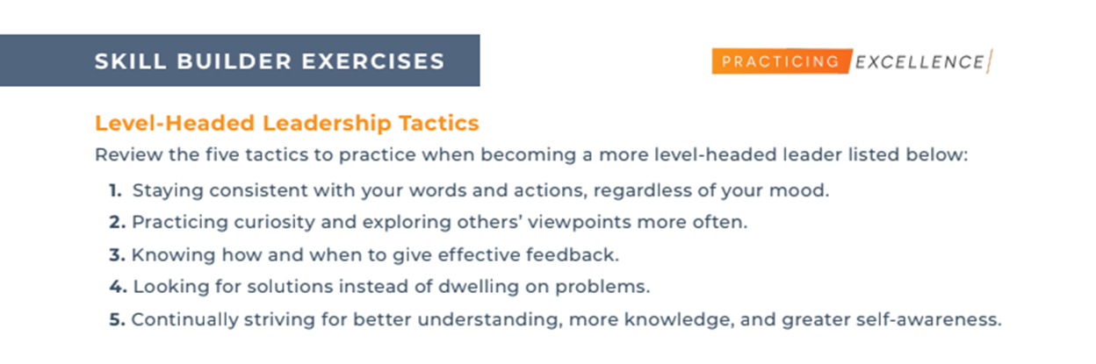
“Level-Headed Leadership Tactics”
Page 10 of your Activation Guide
Notes:
Here’s your workbook support to help your actions align with being the more effective leader you can be.
Five proven tactics that level-headed leaders adopt and make a part of the way they lead

Slide 28
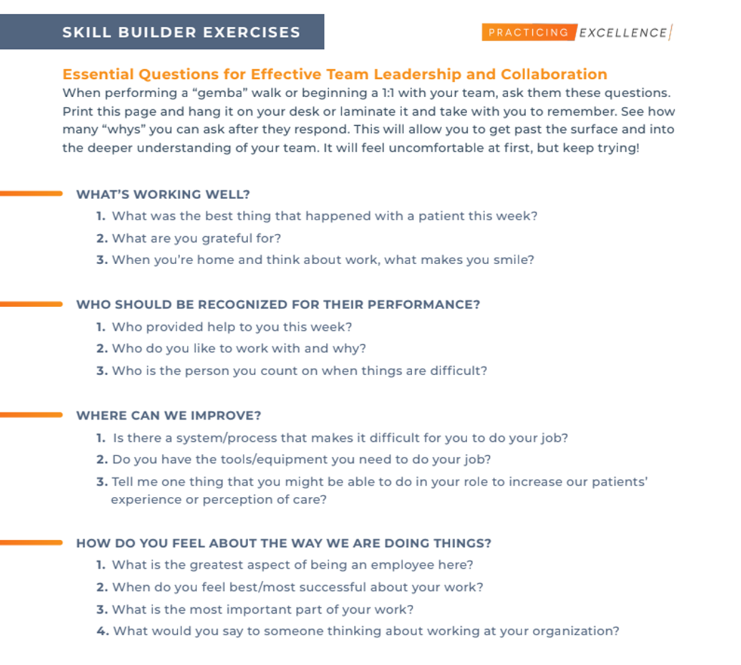
“Leadership By Walking Around” (LBWA) Essential Questions
Page 11 of your Activation Guide
Notes:
Leadership by Walking around – this is just like it sounds. Get out there on the floor and observe what’s happening. Go back to old fashioned rounding and mix it up from your norm by using these helpful questions we’ve included here. The best way to have your team trust you and for you to be able to grow yourself and your team is by being visible and listening to them. This cannot be stressed enough.

Slide 29
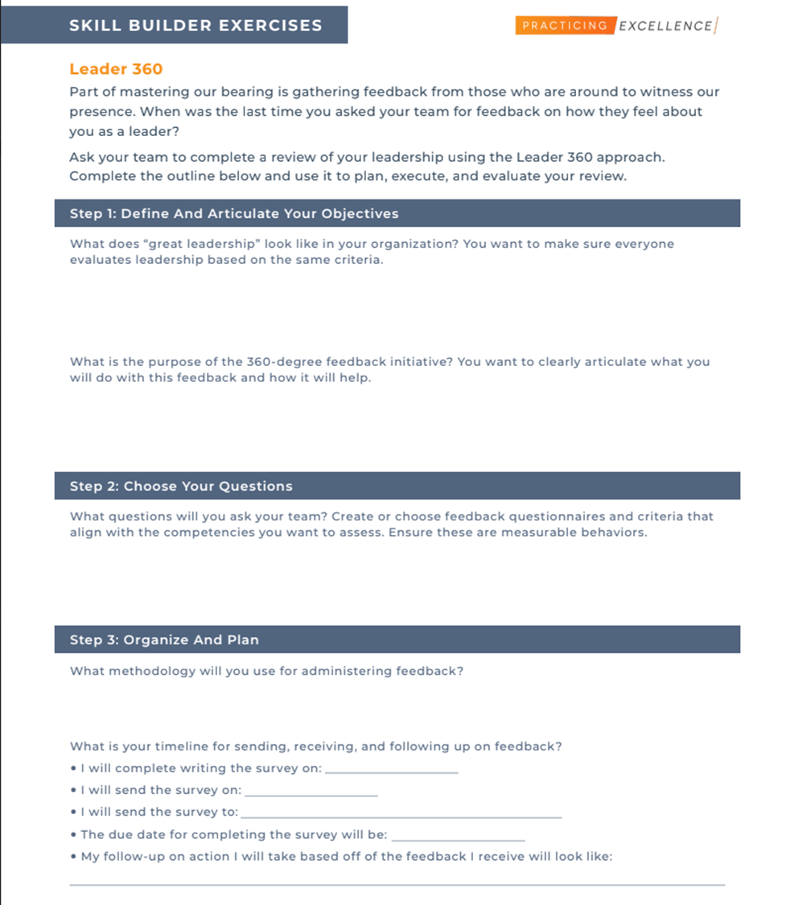
Leader 360
Page 12 of your Activation Guide
Notes:
Leader 360 – How will you know what areas you need to grow in, if you never ask for feedback and your team is the best place to get feedback because they are the recipients of where you have and still need development as a leader. As a leader, I like to do this once a year. This feedback is just essential for my growth and development and for the teams success. I’ve also experienced leadership where I say man I really wish my leader would ask and truly receive some feedback for their blindspots so this is not just for you

Slide 30

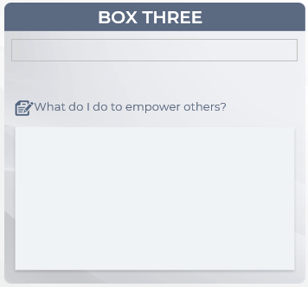
What do I do to
empower others?
Fill in your answer in Box 3 on page 6 of your Activation Guide.
INSERTIMAGE OF DESIGNED BOX WITH ONE HIGHLIGHTS
Notes:
Gooing back to our reflection boxes:
We said Inspiration is the spark that makes someone want to climb the mountain well Empowerment is giving them the rope, training, and authority to actually climb it
Think of it like handing someone the keys to a car - but not just the keys, right? You make sure they have a full tank of gas, a clear map, and the confidence to drive.
Being an empowering leader isn't about just telling people 'You've got this!' and walking away. It's about rolling up your sleeves and setting them up for success - giving them the tools, the authority, and yes, the actual power to make things happen. It's clearing the roadblocks before they hit them and building a path where they can really shine. When you do it right, you're not just delegating tasks - you're building people up so they can tackle bigger challenges on their own."
So take 30 seconds and answer this question in the box on page 6

Slide 31
WHAT DO I DO TO EMPOWER OTHERS?
Unmute and share what you wrote!
Notes:
Have the group come off of mute and share plus use the chat

Slide 32

What do I do to empower others?
ACTIONS I WILL TAKE TO
DEVELOP OTHERS
Notes:
We asked you what do you do to empower others?
What you see in the box are the ACTIONS YOUR WILL TAKE TO DEVELOP OTHERS

Slide 33
03
ACTIONS I WILL TAKE TO DEVELOP OTHERS
Workbook Support:
Promote teamwork over competition.
Adopting a leadership by coaching method using the Socratic Method
Trust your team.
Team dream sessions
Encourage team to set their own stretch goals.
Leading to Engage Part 4: Intellect
Skill #3: Tapping Team Intelligence
Notes:
Here are some ways you can take actions to develop others:
Promote teamwork over competition - Encourage collaboration by creating opportunities for team members to work together and share their knowledge and skills and Leverage diverse strengths: Recognize the unique talents of each team member, and create projects that tap into those strengths.
Trust your team and show them that you trust them by giving them showing them you believe in their abilities. This boosts confidence and motivates them to take ownership of their work and Provide autonomy where possible, allowing them to make decisions and solve problems independently. Total ownership and total accountability. If something goes wrong – you’re on their side and there to support, not scold. The best way we all learn is by doing and the best way to develop others is support them doing
It’s likely you’ve done stretch goals with your team but have you ever let them completely dictate this? First, make sure youre having bi-annual goal setting conversations. Tracking successes, celebrating wins and one of those goals should be completely driven by where the team member wants to grow and supported by you.
Tapping team intelligence

Slide 34
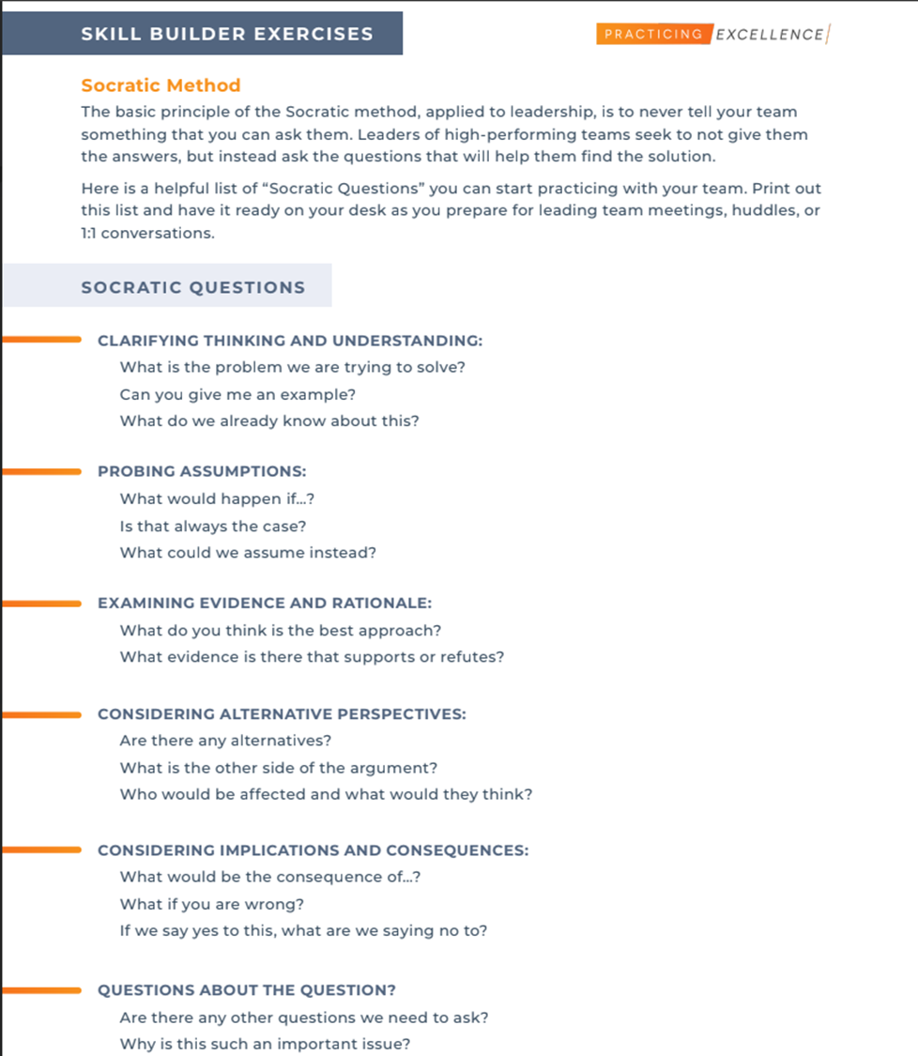
Adopting a leadership by coaching method using the Socratic Method
Page 13 of your Activation Guide
Notes:
Going to your workbook support to help you with this
Adopting a leadership by coaching method using the tried and tested Socratic method. If you check out page 13 in your Activation Guide you have what those questions might look like

Slide 35
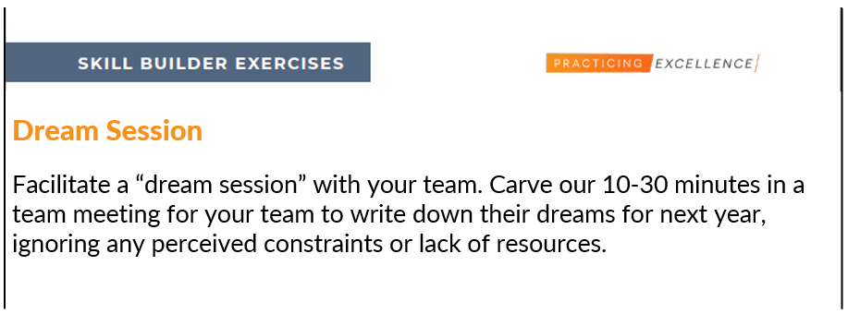
Team dream sessions
Page 14 of your Activation Guide
Notes:
I love team dream sessions. You carve out maybe 10 minutes at a monthly meeting and ask you team to write down their dreams for the next year – ignoring any perceived constraints or lack of resources. Have them share and ideate together as a group. What can come out of this can reveal strengths you didn’t’ know about, ideas you hadn’t thought about yet and give you an idea of how empowered your team already feels or doesn’t feel.

Slide 36
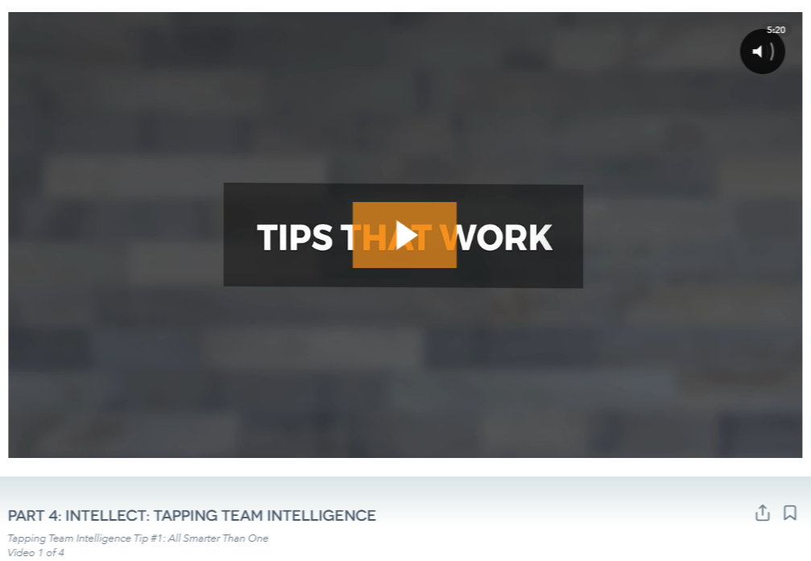
Leading to Engage Part 4: Intellect
Skill #3: Tapping Team Intelligence
Notes:
https://app.practicingexcellence.com/s hare/4583
This is an awesome skill in the LTE series that I just had to point out and you can click on in your AG guide after CONNECT today and watch anytime it’s a whole skill about tapping the intelligence on your team – it’s so powerful I highly recommend you watch it

Slide 37

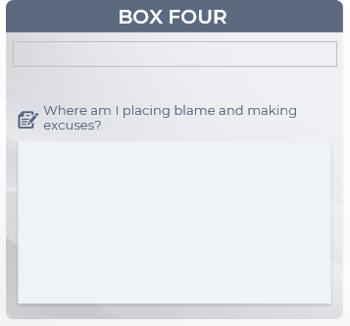
Where am I placing blame and making excuses?
Fill in your answer in Box 4 on page 7 of your Activation Guide.

Slide 38

WHERE AM I PLACING BLAME
AND MAKING EXCUSES?
Unmute and share what you wrote!
Notes:
Have the group come off of mute and share plus use the chat

Slide 39
Where am I placing blame and making excuses?
IN WHAT AREAS DO I NEED TO ADJUST MY MINDSET?
Notes:
We asked you where am I placing blame and making excuses
These are the areas you need to adjust your mindset. These will likely not go away and if they do, they’ll likely get replaced. The 24 hours in a day is here to stay. You having a boss or someone to report to making decisions above you is here to stay and your team is looking to you to help model what we do with these things instead of making excuses and placing the blame

Slide 40
IN WHAT AREAS DO I NEED TO
ADJUST MY MINDSET?
04
Workbook Support:
Eliminate “I don’t have time” from your vocabulary.
Manage your time and priorities using the Eisenhower Matrix.
Take the growth mindset approach through careful questioning.
Conquer challenges with your time using the Tackling Challenges framework.
Let go of the outcome.
“Leaders Don’t Have The Right To a Bad Day.”
Notes:
Where do I need to shift my mindset and approach to challenges? What’s getting in my way
Eliminate “I don’t have time” from your vocabulary – Change this to “It’s not a priority” Time management/priroities – It’s nothat you don’t have time it’s that it’s not a priority, we have the same amount of time as the CEO of NASA
Take the growth mindset approach by asking yourself questions that will help you see challenges or straight up ridiculousness in your work as an opportunity. I want you to ask yourself “What can I learn from this?” “What do I think this is trying to teach me?” “How can I replace this negative thought stream with a positive one?)
Let go of the outcome – focus on doing your best, with the best attitude, within what you control and then mentally release the need to control the outcome or other peoples reactions. The sun can be shining on two people and one will say it’s too hot and the other will be thankful for the light – attitude is everything.

Slide 41
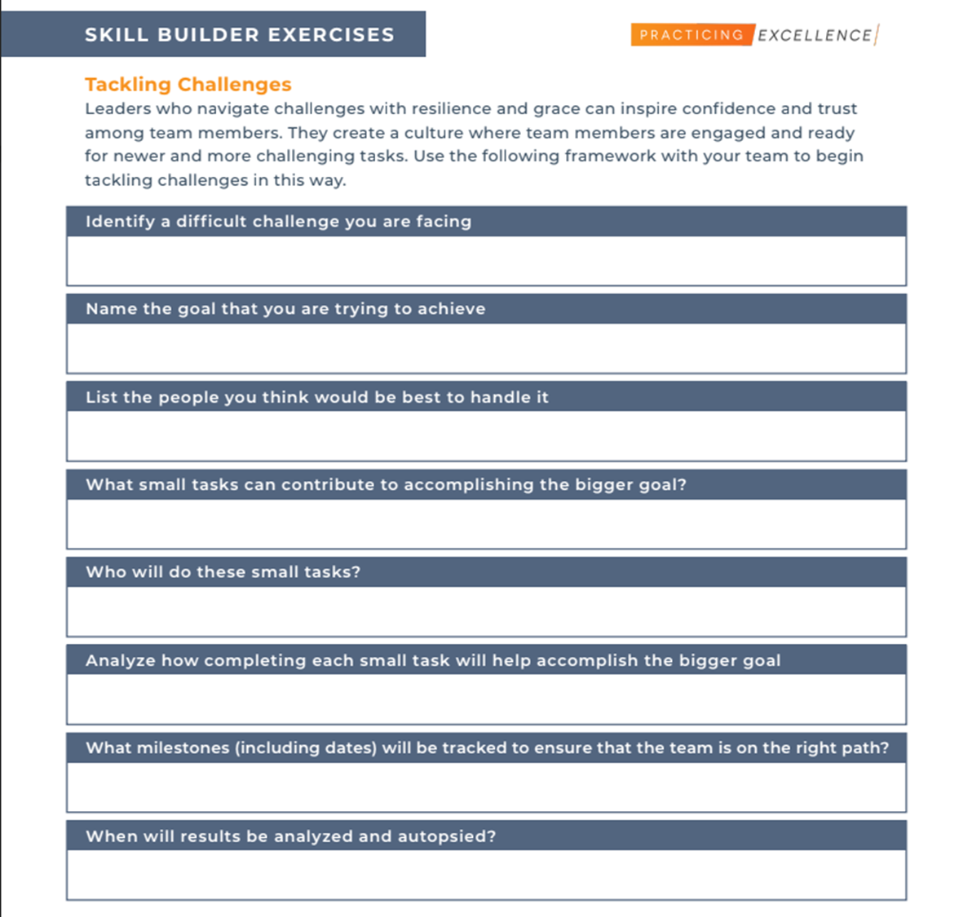
Conquer challenges with your time using the Tackling Challenges framework
Page 15 of your Activation Guide

Slide 42
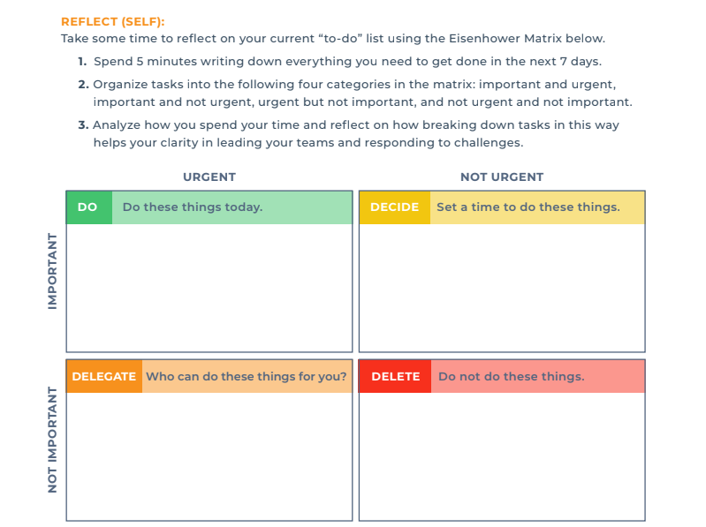
Manage your time and priorities using the Eisenhower Matrix
Page 16 of your Activation Guide

Slide 43

“Leaders Don’t Have The Right To A Bad Day”
Page 17 of your Activation Guide
Notes:
Pag. 17 of Part 3

Slide 44

BOX ONE
BOX TWO
DAILY LEADERSHIP HABITS TO FORM TODAY
THE ACTIONS THAT ALIGN WITH THE LEADER I WANT TO BE
How do I inspire others?
In what areas do I need to grow or improve to become a more effective leader?
Encouraging words
Delegation
Meaning what I say
Active listening
Positivity
Growth mindset
Meaningful action
LEADERSHIP MATRIX
BOX THREE
BOX FOUR
THE ACTIONS I WILL TAKE TO DEVELOP OTHERS INTO LEADERS
WHERE DO I NEED TO SHIFT MY MINDSET?
What do I do to empower others?
Where am I placing blame and making excuses?
Giving away ownership and accountability
I don’t have enough time
I don’t have enough autonomy
Listen more
Making development plans
Notes:
When you putt his all together, you can see that what you have in you – you at your best, who you want to be, success you have had – that’s what it takes to engage your team. You already have it. You can be an engaging leader with clear goals, consistent effort and focus and commitment.

Slide 45

MY LEADERSHIP PROMISE.
Notes:
So I’m going to ask you to make a commitment right now

Slide 46
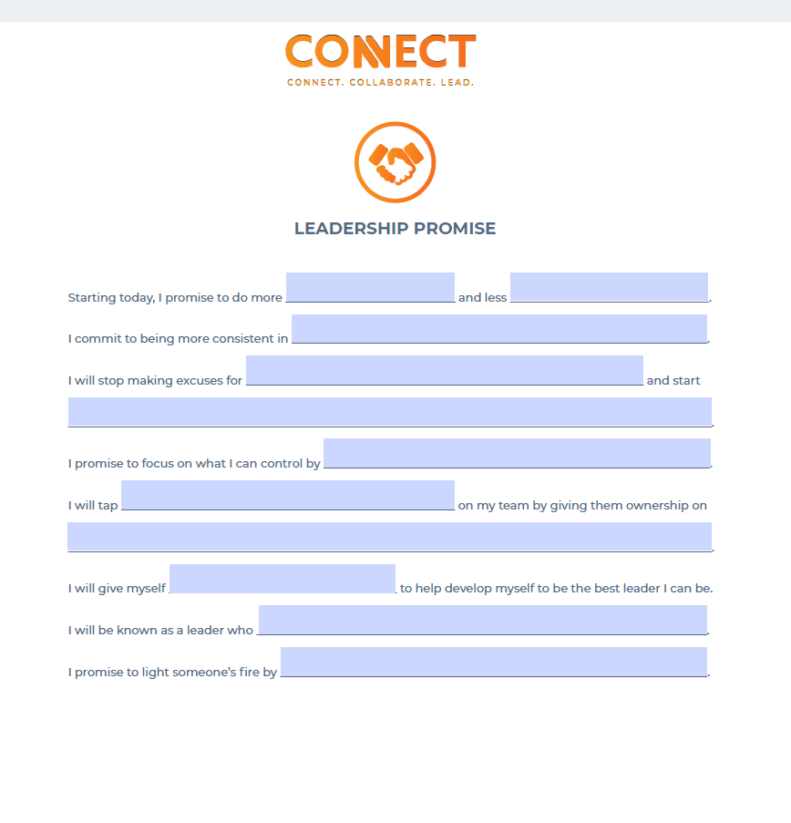
My Leadership Promise
Your task: turn to the last page in your Activation Guide.
Reflect on the leadership matrix you completed in the previous section, along with the leadership actions we reviewed.
Create your leadership promise by filling in the blanks.

Slide 47


LET’S SHARE!
Notes:
Need 3 minutes for the end

Slide 48
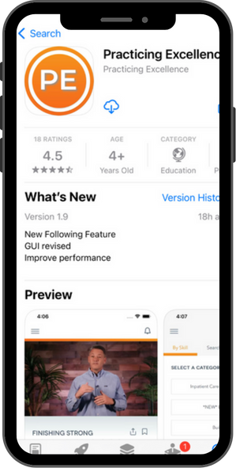

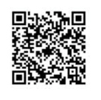
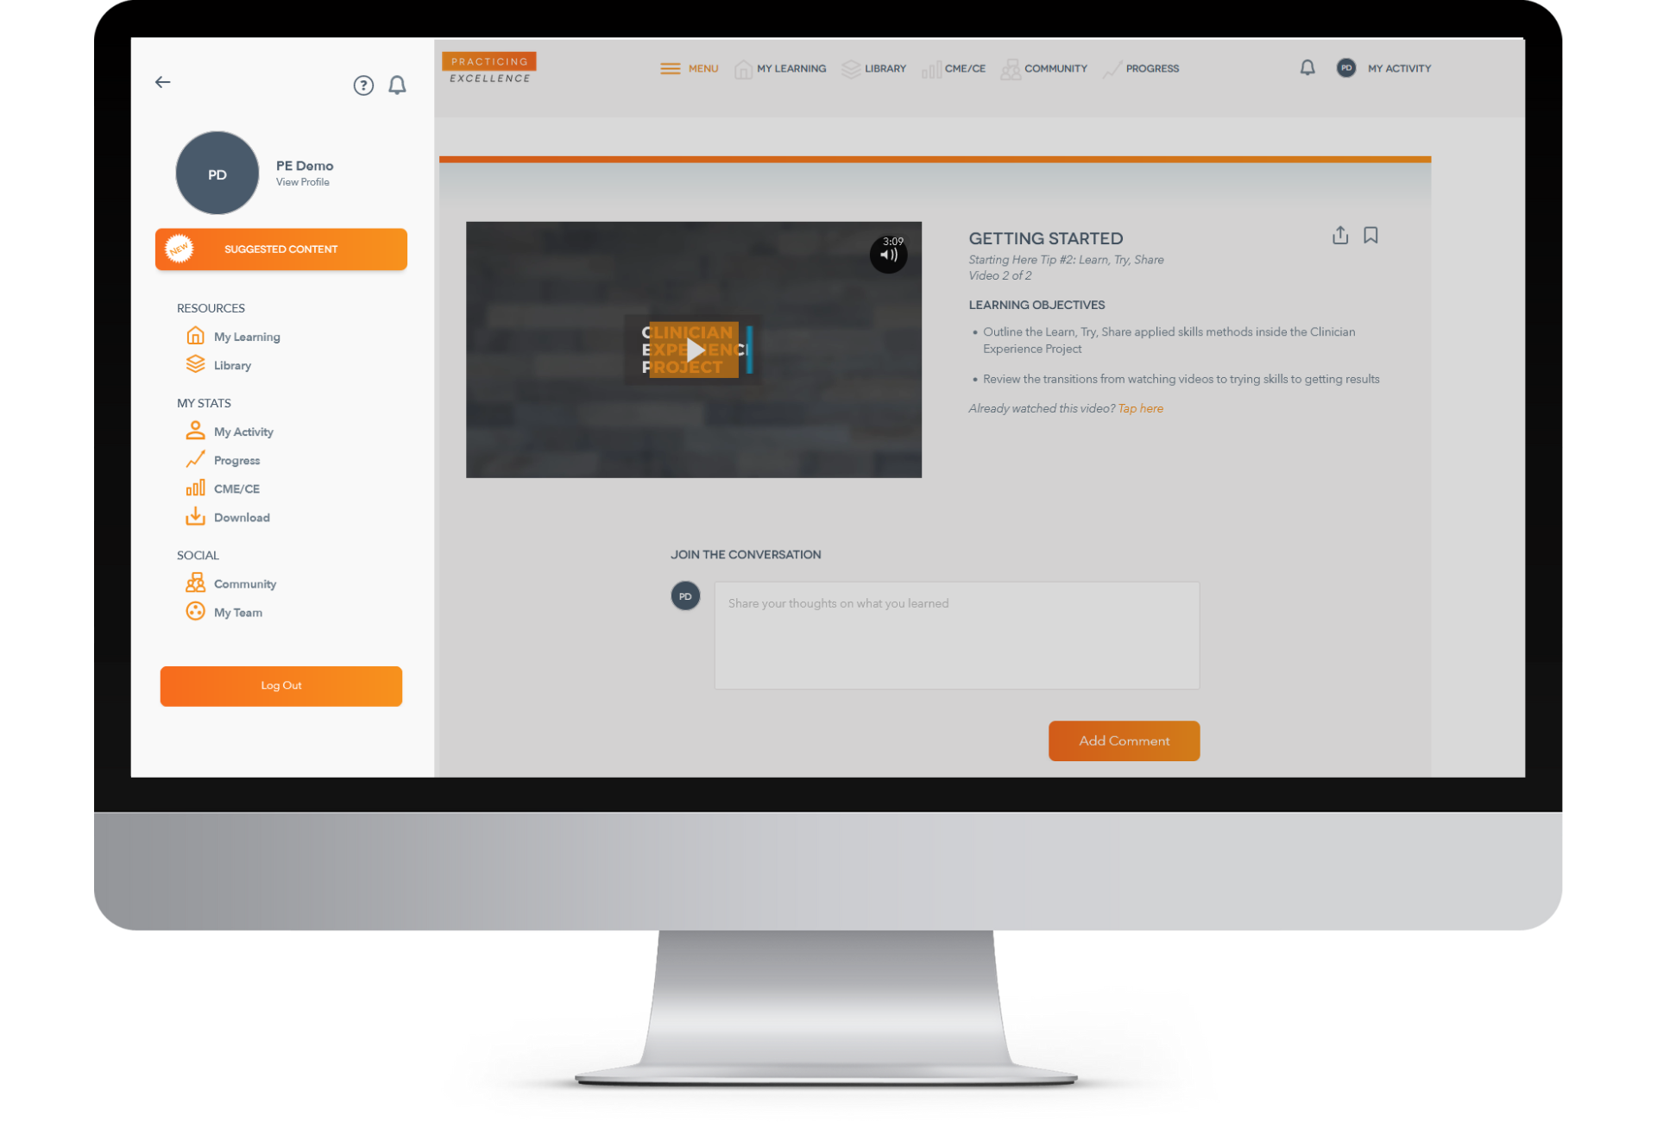
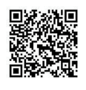

Let’s Log On!
https://app.practicingexcellence.com
Open your mobile device camera and hover over the QR code to link directly to Practicing Excellence app download or
Search “Practicing Excellence” in the Apple App Store for iPhone users or the Google Play store for Android users and download mobile application.
Notes:
*Sam drop hyperlink
https://app.practicingexcellence.com/
Alright! Let’s log on. Of note, for those of you who’ve already registered and logged on in the past, that’s great! I’m still going to have you log in and follow along because we’re going to help you find and save the Leading To Engage Content

Slide 49
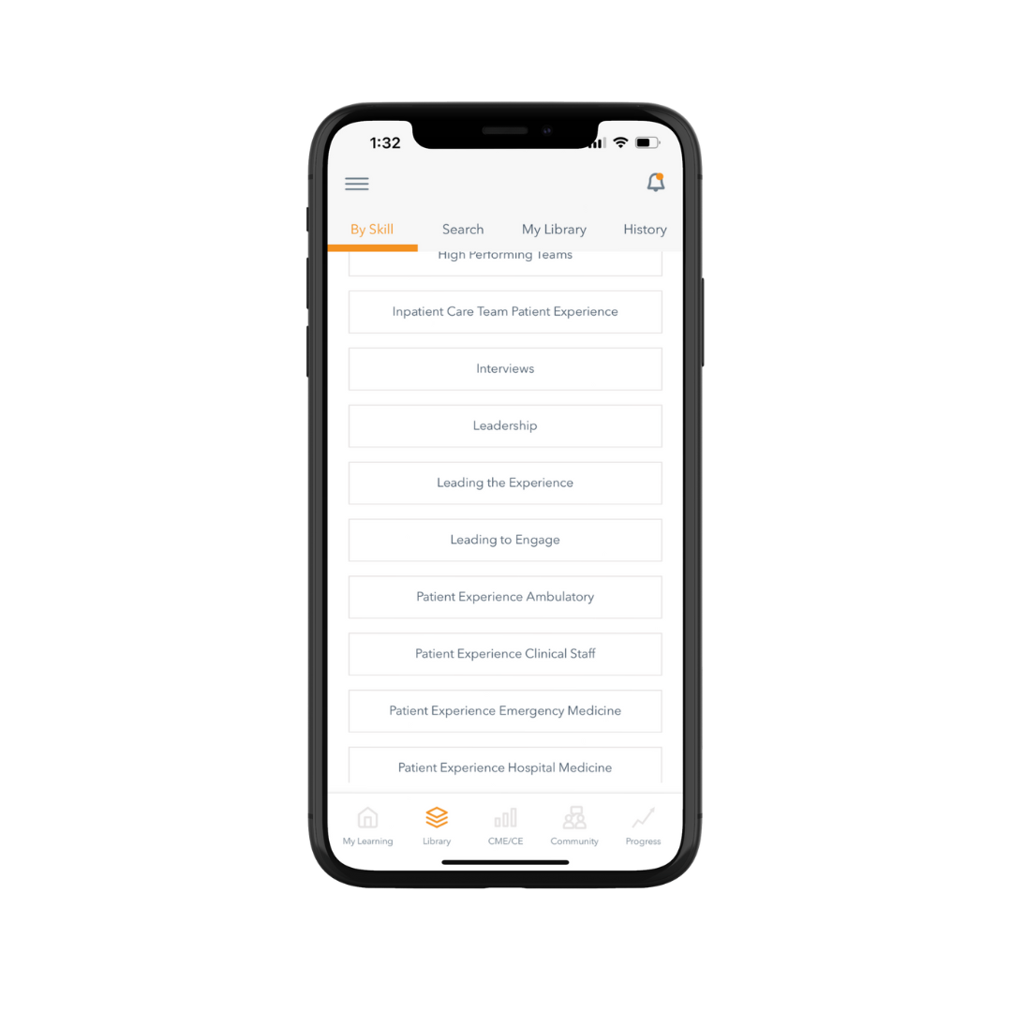
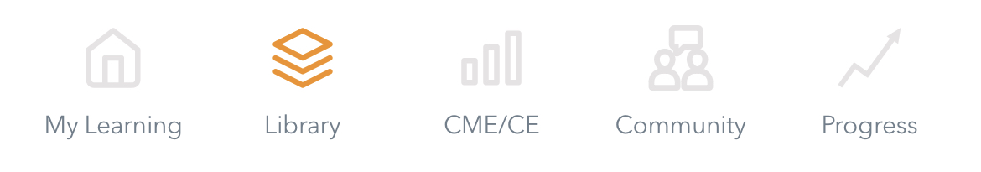
Let’s find the Leading To Engage Series
Notes:
Practicing Excellence has historically offered CME credit for most skills included in the Clinician Experience Project but something you told us was you wanted Continuing Education credits as well. We are thrilled to announce that with our Joint Accreditation, nursing professionals can now claim CE credits toward contact hours for completion of the Practicing Excellence skills.

Slide 50
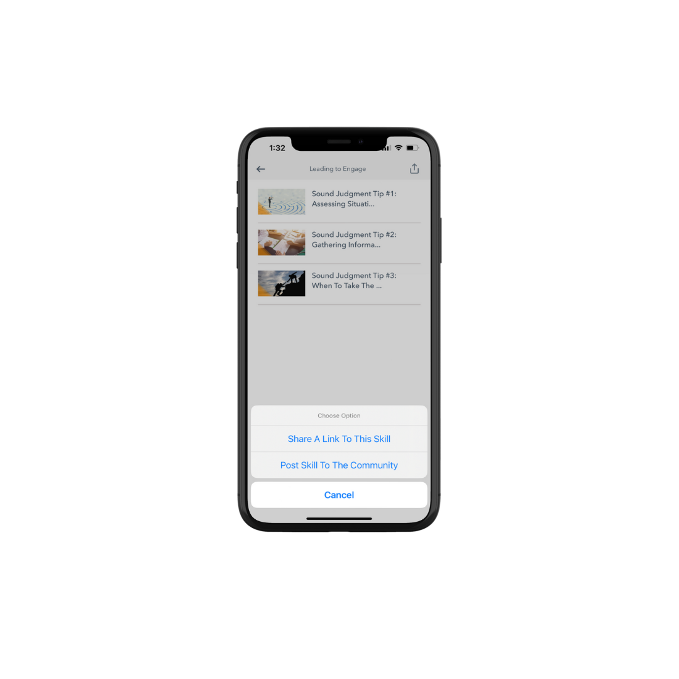
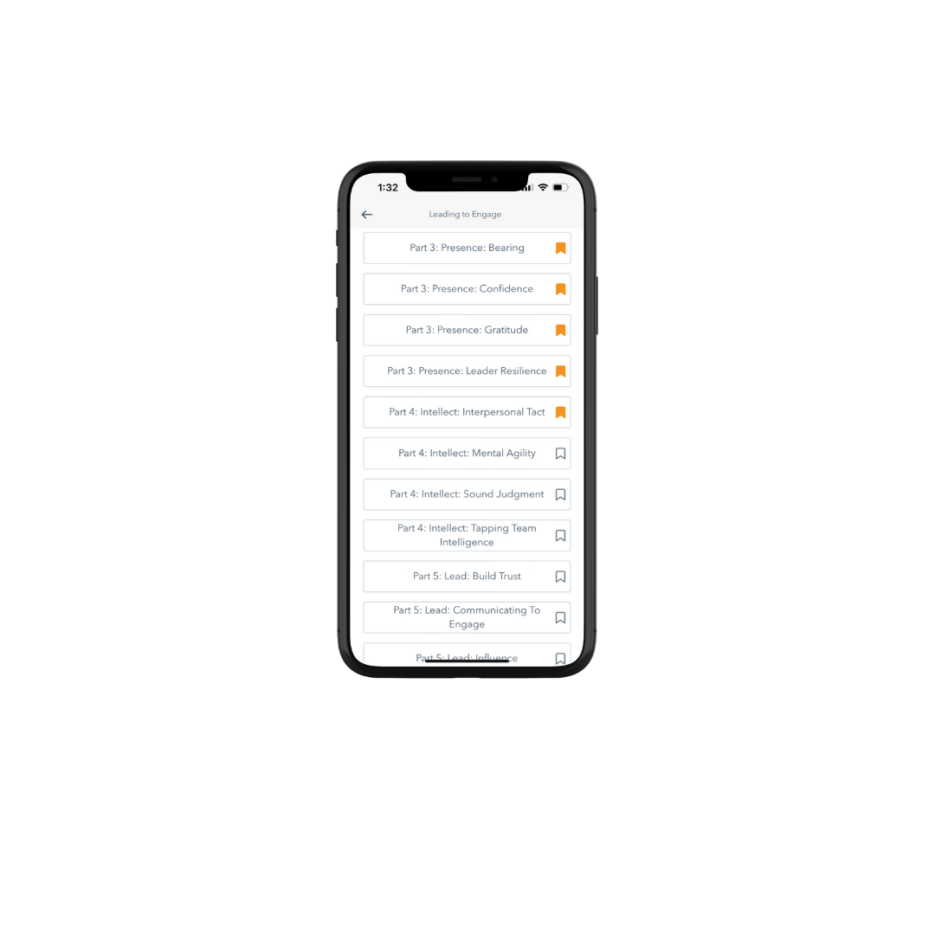

Saving and Sharing Content
Save the content and come back to it in My Library
Share with fellow or emerging leader

Slide 51

LEADING TO ENGAGE
CERTIFICATION PROGRAM
WORKBOOK
Notes:
https://knowledge.practicingexcellence.com/wp-content/uploads/2024/11/LTE-Workbook-1-5.pdf

Slide 52
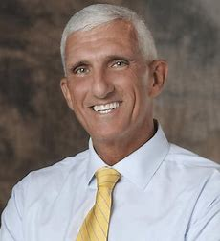
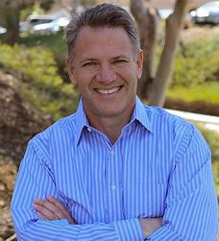
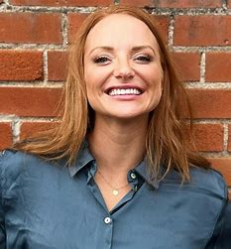
W
LEADING TO ENGAGE WORKSHOP
December 16, 2024
2:00pm – 3:00pm EST / 11:00am – 12:00pm PST
All Practicing Excellence users invited!
MARK HERTLING
DR. STEPHEN BEESON
SAM HICKERT
Notes:
https://info.practicingexcellence.com/leadingtoengagedec

Slide 53

Before you are a leader, success is all about growing yourself. When you become a leader, success is all about growing others.
– Jack Welch

Slide 54

W
THANK YOU

